Slide 1
Clinical Guide to Transfusion, Chapter 15, Irradiated, washed and CMV-tested blood components
Figure 1. Closed-system, automated
washing procedure for red blood cells at
Canadian Blood Services.
Public (P)

Slide 2
Purpose: These figures were created for Chapter 15, Irradiated, washed and CMV-tested blood components of the Clinical Guide to Transfusion and are provided as downloadable resources to support education and knowledge translation activities.
Disclaimer: These materials are provided for educational and informational purposes only and are not intended to replace professional judgment or the complete information and context provided in the full chapter. For complete information, including context, indications, and limitations, please refer to the Clinical Guide to Transfusion on ProfEdu.ca.
Suggested citation:
Syed T, Prokopchuk-Gauk O & Solh Z. Irradiated, washed and CMV-tested blood components (Figure 1). In: Khandelwal A, Brooks K, editors. Clinical Guide to Transfusion [Internet]. Ottawa: Canadian Blood Services, 2026 [cited YYYY MO DY]. Chapter 15. Available from: https://professionaleducation.blood.ca

Slide 3
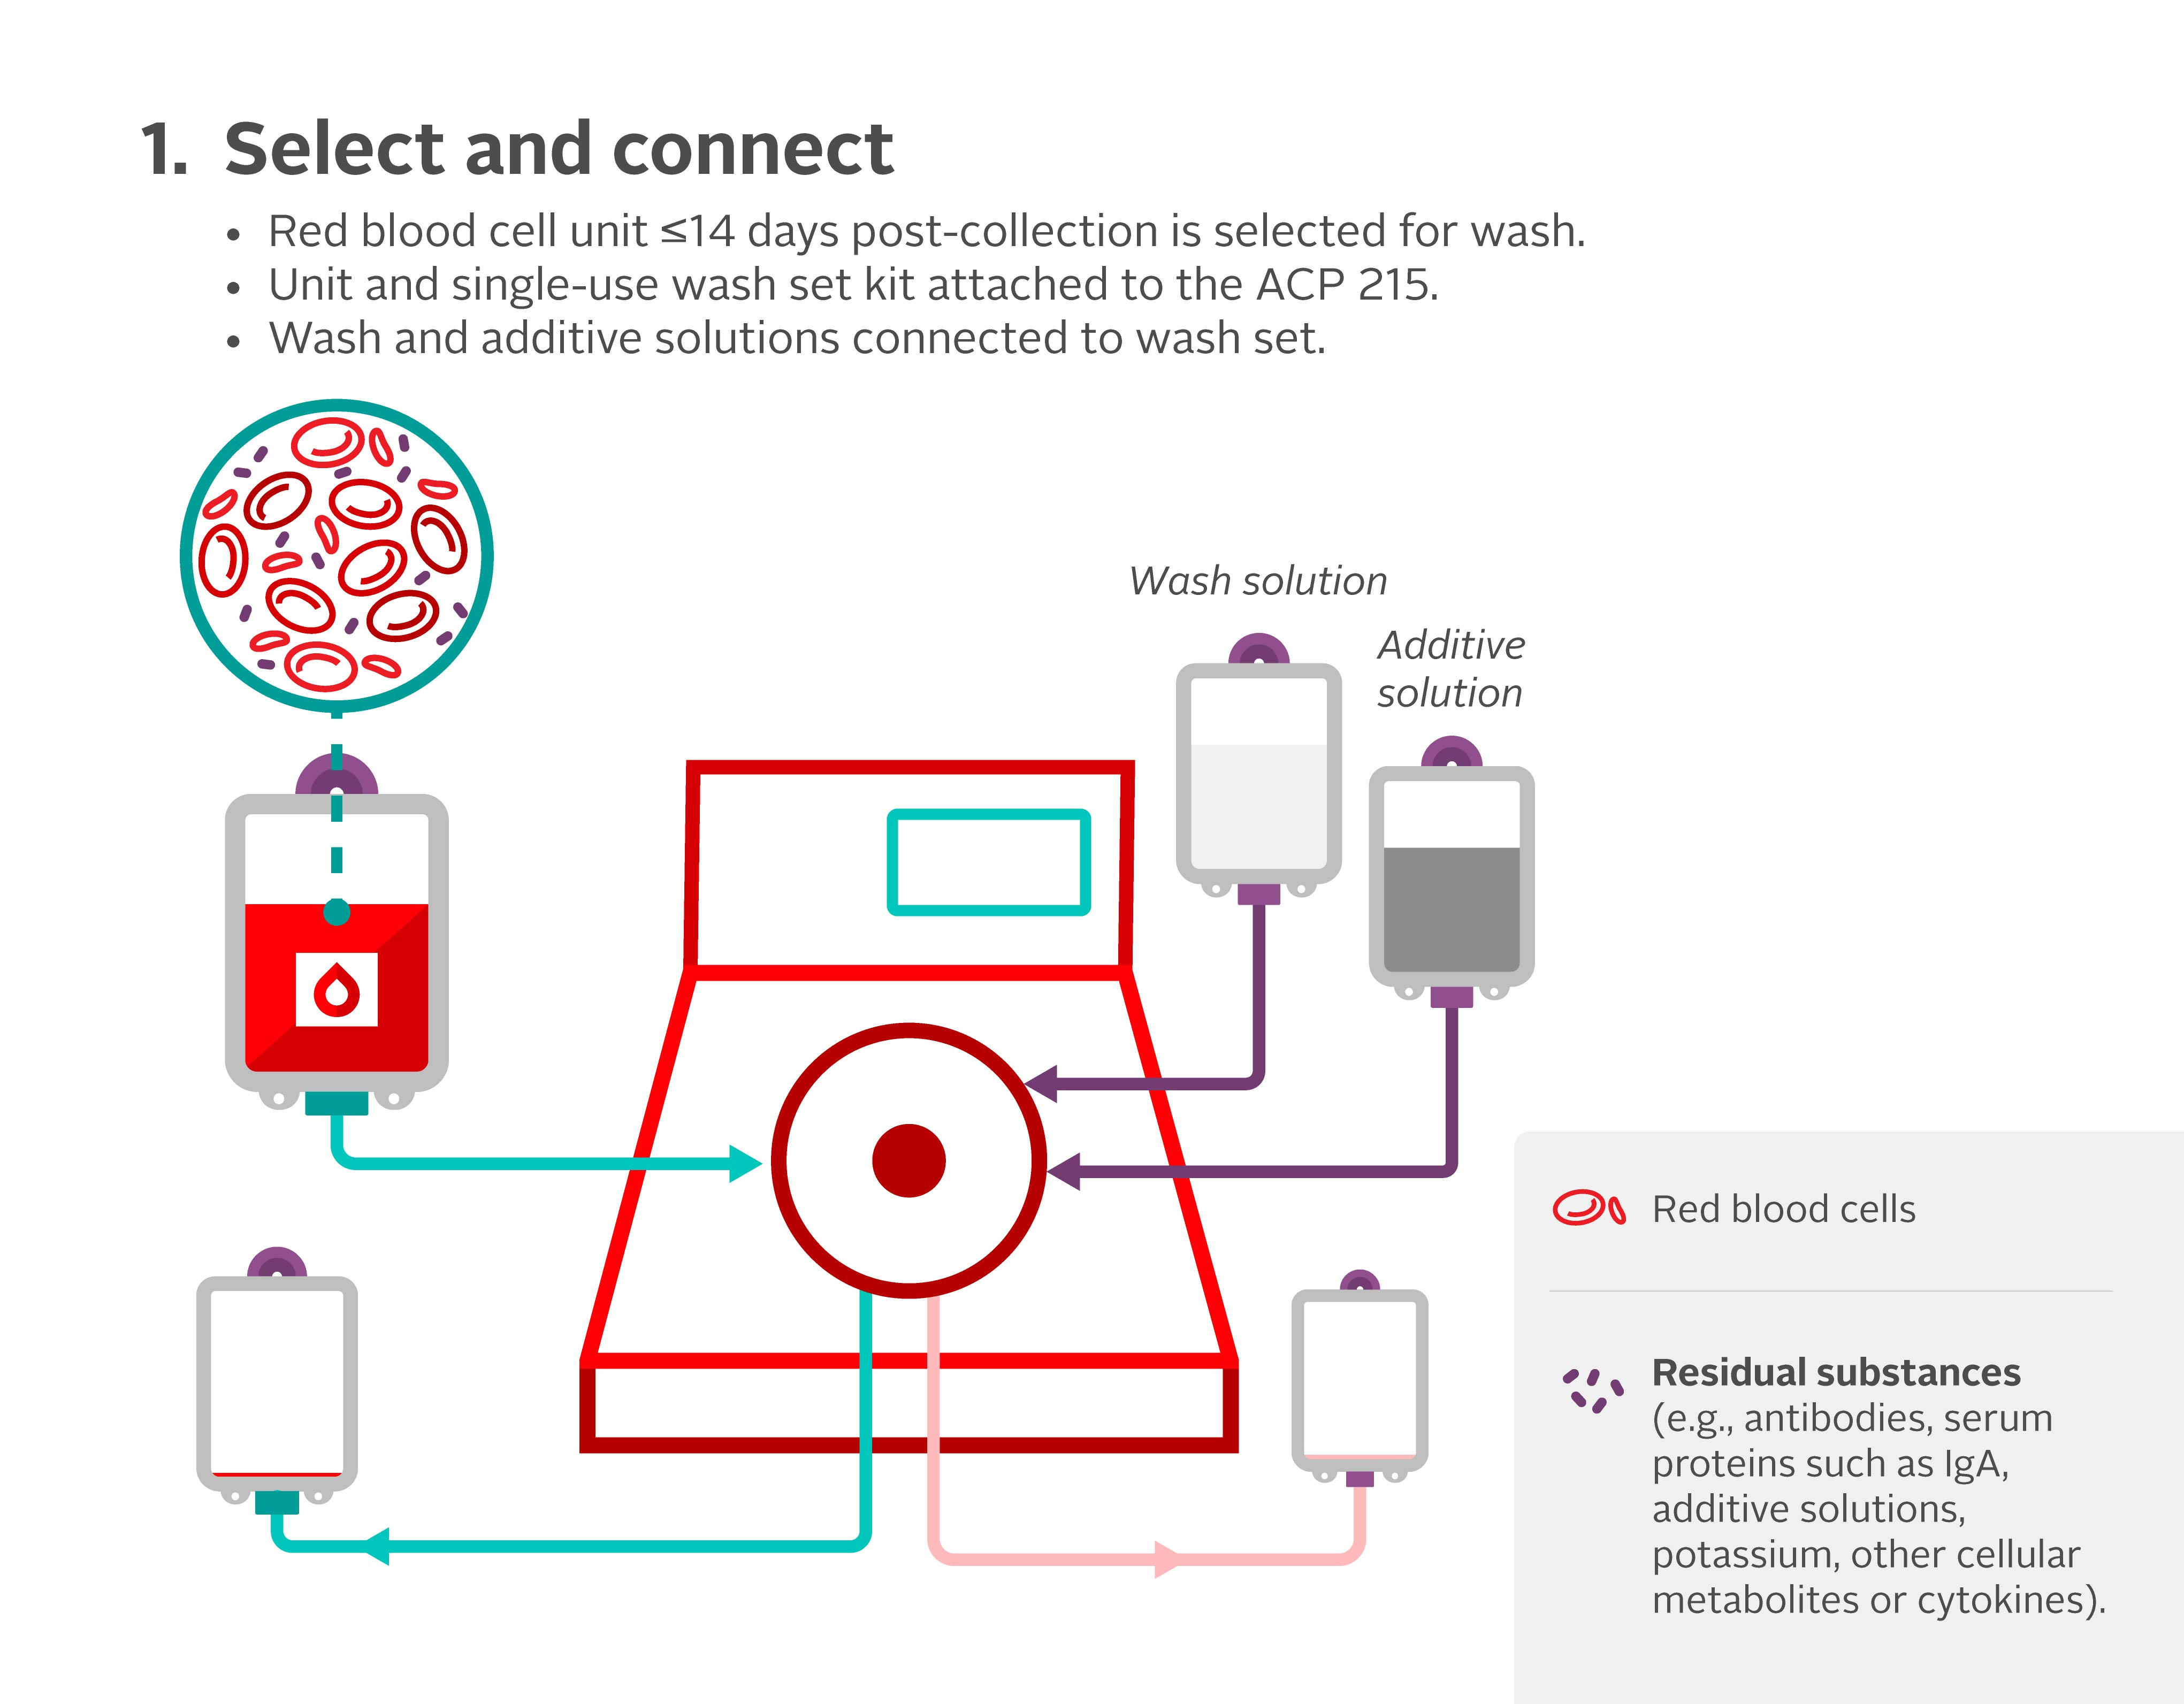
Clinical Guide to Transfusion, 2026

Slide 4
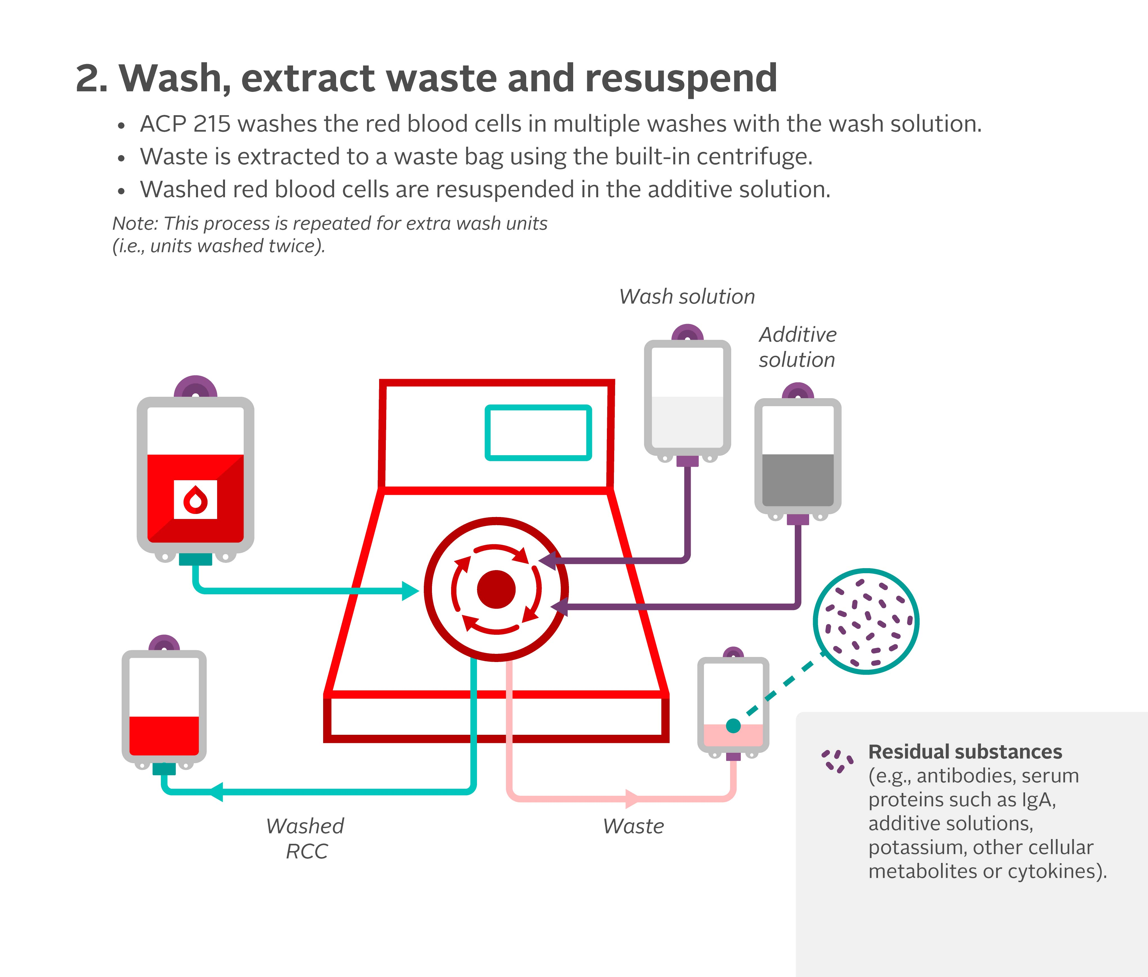
Clinical Guide to Transfusion, 2026

Slide 5
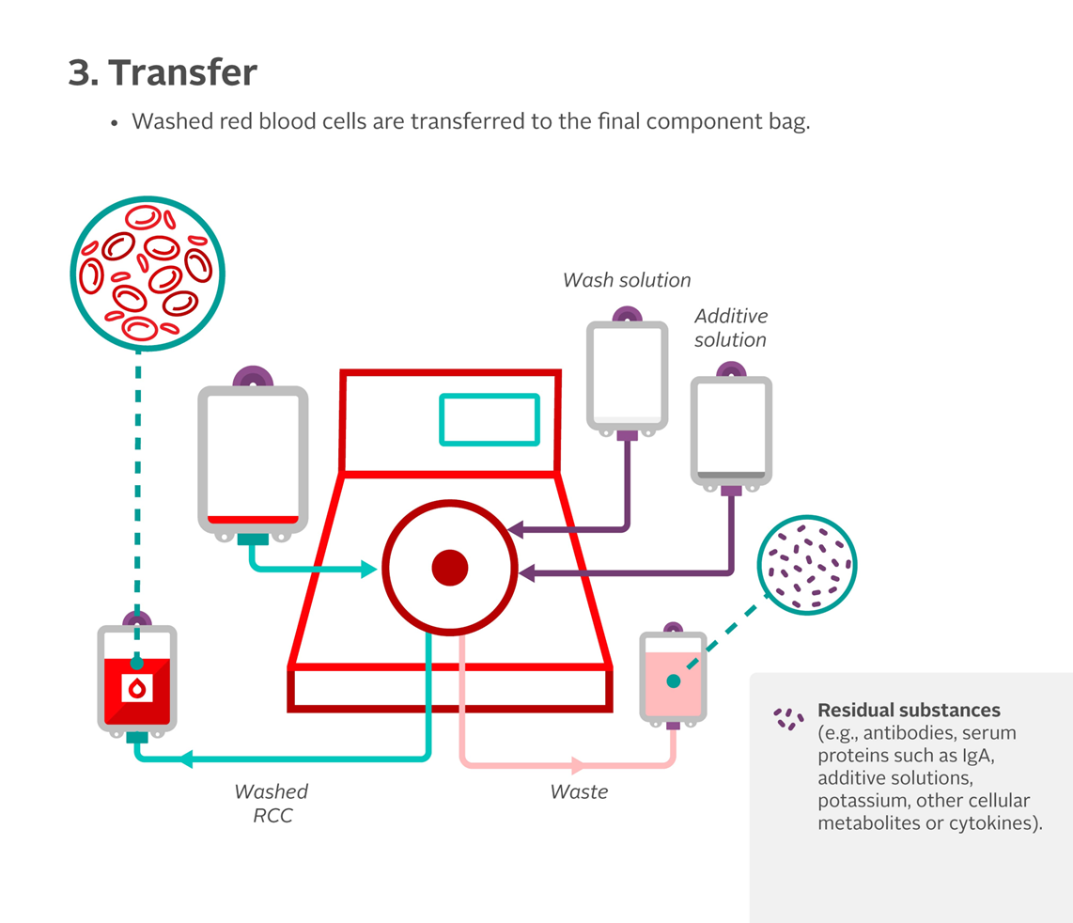
Clinical Guide to Transfusion, 2026

Slide 6
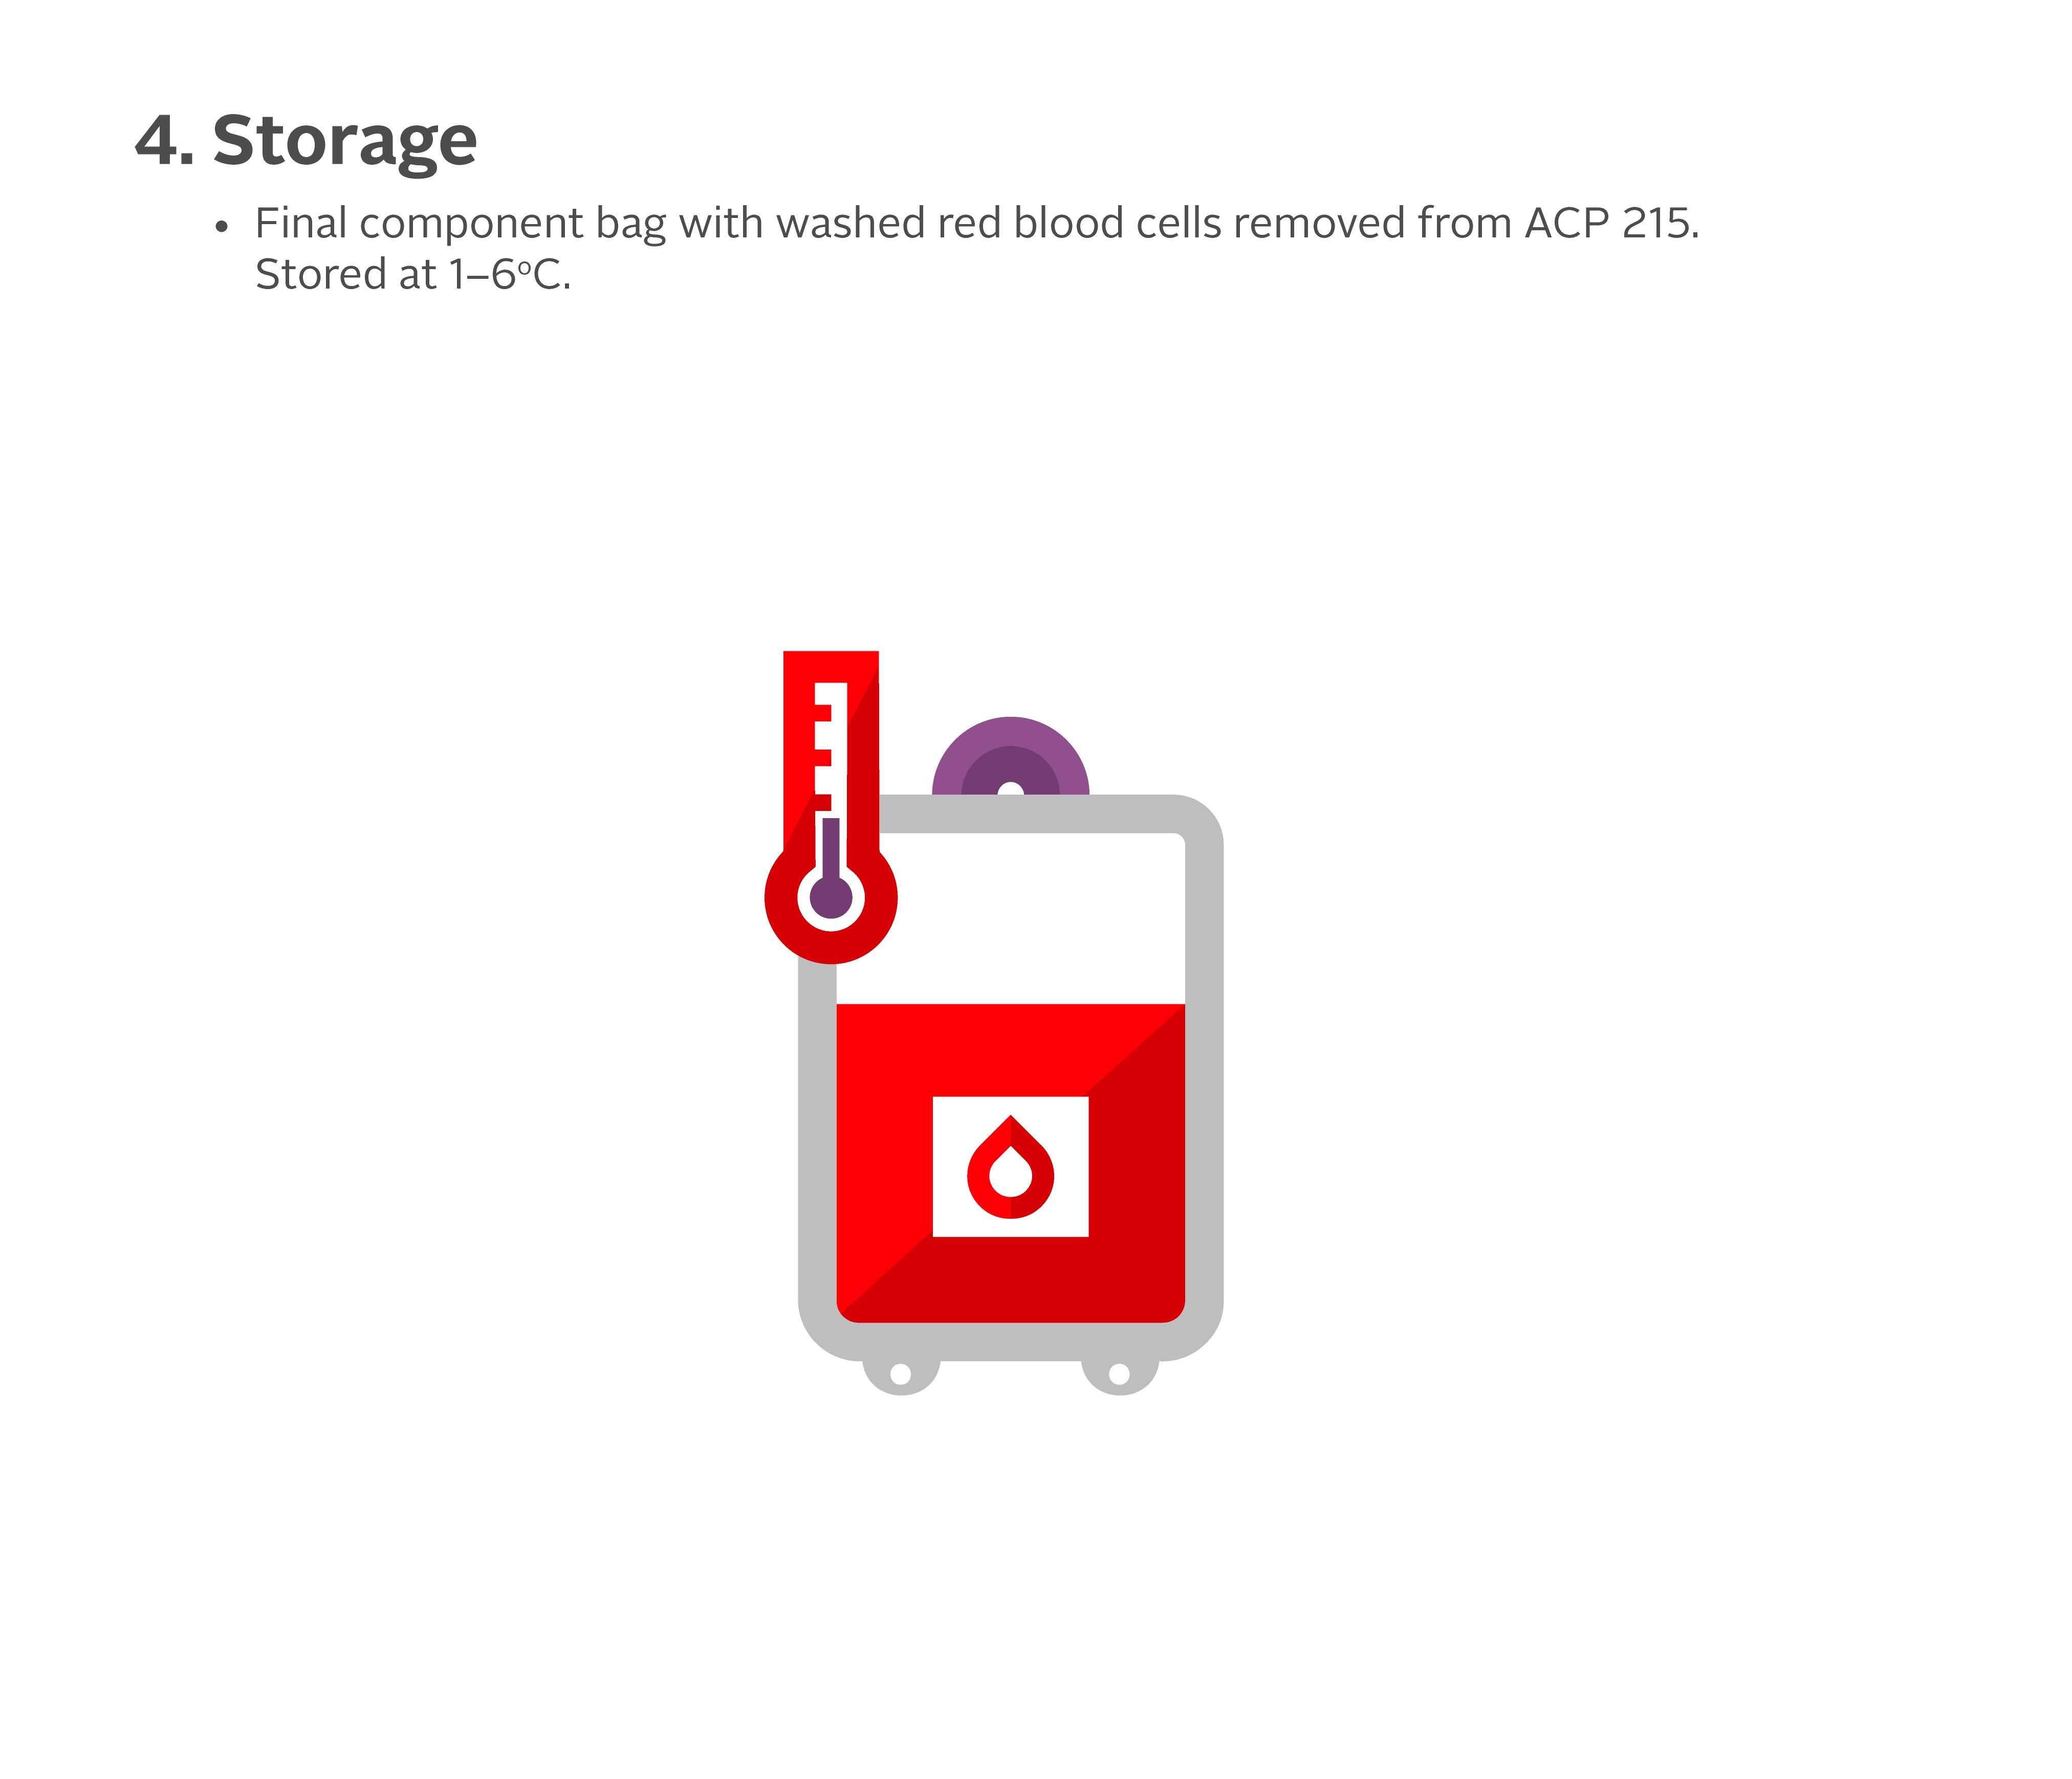
Clinical Guide to Transfusion, 2026

