Slide 1
Mythbusters
Use of Intravenous Albumin:
A Guideline from the International Collaboration for Transfusion Medicine Guidelines (ICTMG)

Slide 2
Purpose
Created for Canadian Blood Services' Breakthroughs in blood webinar series, these slides support knowledge mobilization for the ICTMG's guideline:
Use of Intravenous Albumin: A Guideline from the International Collaboration for Transfusion Medicine Guidelines.
Mythbusters authors
Jeannie Callum, MD, FRCPC; Edward (Ted) Clark, MD, FRCPC; Bram Rochwerg, MD, MSc, FRCPC; James Daly, MBBS, FRACP, FRCPA; Sheharyar Raza, MD, FRCPC; and Alexander Vlaar, MD, PhD, MBA
Swipe to learn more…
Developed 30-10-2024; Educational / informational purposes only.
Available on Canadian Blood Services’ professional education website, Profedu.ca, Breakthroughs in blood webinar series.

Slide 3
Myth #1
There is no risk of harm with IV albumin as it is safer or “more natural” compared to crystalloid.
Reality
The manufacturing process (alcohol fractionation, heat treatment) may impact albumin's normal function.
Albumin results in an increase in:
adverse pulmonary events in RCTs (China et al., 2021; Wong et al., 2020)
bleeding and infections compared to crystalloid in cardiac surgery (Pesonen et al., 2022)
Developed 30-10-2024; Educational / informational purposes only.
Available on Canadian Blood Services’ professional education website, Profedu.ca, Breakthroughs in blood webinar series.

Slide 4
Myth #2
Albumin is not very costly.
Reality
Albumin is much more expensive than crystalloids.
Albumin is manufactured from large volumes of plasma and is expensive (approx. $130/25 g USD; warehouse acquisition cost of albumin), with the acquisition cost likely a fraction of the total health care expenditure (Shander et al., 2010).
Developed 30-10-2024; Educational / informational purposes only.
Available on Canadian Blood Services’ professional education website, Profedu.ca, Breakthroughs in blood webinar series.

Slide 5
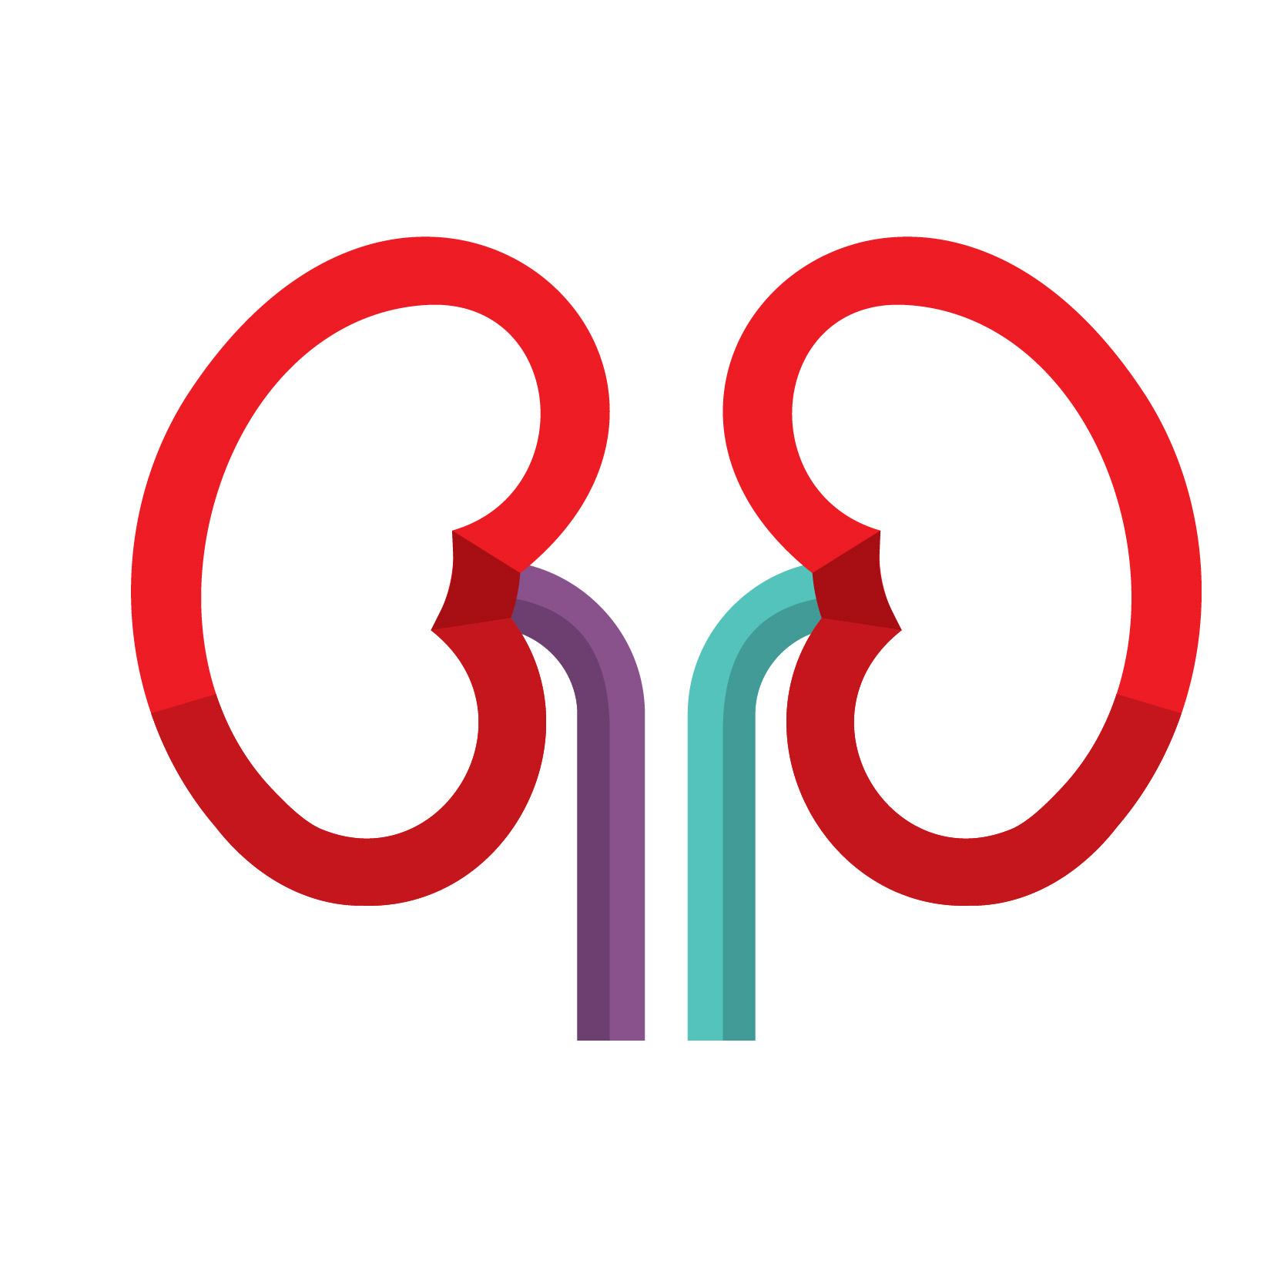
Myth #3
There is great evidence for using albumin in hepatorenal syndrome (HRS).
Reality
All prior trials involving HRS (Thomson et al., 2020;
Best et al., 2019) have administered albumin in both treatment and control arms while comparing vasoconstrictors (e.g., terlipressin, midodrine) to placebos.
It remains unknown if albumin is a beneficial (or harmful) component of regimens routinely used to treat patients with HRS.
Developed 30-10-2024; Educational / informational purposes only.
Available on Canadian Blood Services’ professional education website, Profedu.ca, Breakthroughs in blood webinar series.

Slide 6
Myth #4
In ICU, intradialytic hypotension (IDH) can only be treated with albumin, not crystalloid or pressors.
Reality
Not all IDH is due to intravascular volume depletion thus giving fluid is not always the appropriate treatment. Given its cost and potential harms, albumin is not recommended for treating IDH over other options.
Small trials have reported transient hemodynamic improvements after hyperoncotic albumin during dialysis; no trials assessed clinically meaningful outcomes
(Hryciw et al., 2021; Douvris et al., 2019).
Developed 30-10-2024; Educational / informational purposes only.
Available on Canadian Blood Services’ professional education website, Profedu.ca, Breakthroughs in blood webinar series.

Slide 7
Myth #5
Low serum albumin is an appropriate indicator for albumin infusion in ICU patients.
Reality
The ALBIOS trial randomized 1818 ICU patients with hypoalbuminemia to receive daily albumin versus crystalloid (Caironi et al., 2014).
Although serum albumin levels increased with transfusion, there was no impact on mortality, organ dysfunction or length of hospital stay.
Developed 30-10-2024; Educational / informational purposes only.
Available on Canadian Blood Services’ professional education website, Profedu.ca, Breakthroughs in blood webinar series.

Slide 8
Myth #6
Better diuresis is achieved in critically ill edematous patients with a “sandwich” of Lasix (furosemide) and 25% albumin.
Reality
While a couple of very small RCTs have examined this question, none have shown any difference with adding albumin to Lasix in improving patient-important outcomes in edematous ICU patients (Oczkowski & Mazetti, 2014).
Developed 30-10-2024; Educational / informational purposes only.
Available on Canadian Blood Services’ professional education website, Profedu.ca, Breakthroughs in blood webinar series.

Slide 9
Myth #7
In sepsis, albumin should be used if additional fluid is required following infusion of several litres of crystalloid.
Reality
In RCTs and systematic reviews evaluating the role of albumin in patients with sepsis, its use has not been found to be associated with improved outcomes.¹⁻⁵
Tseng, CH et al. Critical Care (2020).
Patel, A et al. BMJ (2014).
Rochwerg, B et al. Annals of Internal Medicine (2014).
Bansal M et al. Current Drug Safety (2013).
Caironi, P et al. New England Journal of Medicine (2014).
Developed 30-10-2024; Educational / informational purposes only.
Available on Canadian Blood Services’ professional education website, Profedu.ca, Breakthroughs in blood webinar series.

Slide 10
Myth #8
In extracellular fluid overload, 25% albumin should be used as a resuscitation fluid.
Reality
Resuscitation fluid of any kind is very rarely indicated in the presence of extracellular fluid overload.
Speculation that using albumin as resuscitation fluid might limit dilutional hypoalbuminemia, thereby reducing the risk of pulmonary edema, has not been shown to be true (Gallager, et al., 1985; Zarins et al., 1978).
Developed 30-10-2024; Educational / informational purposes only.
Available on Canadian Blood Services’ professional education website, Profedu.ca, Breakthroughs in blood webinar series.

Slide 11
Myth #9
Albumin should be given during large volume paracentesis to prevent hypotension.
Reality
Albumin infusion is not routinely indicated before or during large volume paracentesis to prevent hypotension.
Albumin is only indicated AFTER the procedure if the volume removed exceeds 5 L, at a recommended dose of hyperoncotic albumin (20-25%) 6-8 g/L of fluid removed (Kulkarni et al., 2020).
Developed 30-10-2024; Educational / informational purposes only.
Available on Canadian Blood Services’ professional education website, Profedu.ca, Breakthroughs in blood webinar series.

Slide 12
Myth #10
Albumin should be given for malignant ascites, just like cirrhosis.
Reality
Guidelines for malignant ascites do not recommend albumin administration (Matsusaki et al., 2022; Becker et al., 2006).
Malignant ascites is an exudative process, unlike transudate ascites in cirrhosis thought to be driven by a low albumin level.
Developed 30-10-2024; Educational / informational purposes only.
Available on Canadian Blood Services’ professional education website, Profedu.ca, Breakthroughs in blood webinar series.

Slide 13
Key takeaways
Intravenous albumin is:
A human-derived blood product manufactured from donated plasma.
Used in a wide range of clinical settings to improve hemodynamics, facilitate fluid removal, manage complications of cirrhosis with highly variable practice between regions.
Swipe to learn more (1/3)…
Developed 30-10-2024; Educational / informational purposes only.
Available on Canadian Blood Services’ professional education website, Profedu.ca, Breakthroughs in blood webinar series.

Slide 14
Key takeaways
Intravenous albumin is:
More expensive to manufacture and provide to patients compared to crystalloids.
Associated with adverse consequences in some cases including fluid overload, hypotension, hemodilution requiring red blood cell transfusion and anaphylaxis.
Swipe to learn more (2/3)…
Developed 30-10-2024; Educational / informational purposes only.
Available on Canadian Blood Services’ professional education website, Profedu.ca, Breakthroughs in blood webinar series.

Slide 15
Key takeaways
ICTMG's Use of Intravenous Albumin guideline provides clinicians with actionable recommendations on indications for albumin use.
12/14 recommendations do not suggest albumin use in a wide variety of clinical situations where albumin commonly is transfused.
Scan to access the guideline (3/3)...
Developed 30-10-2024; Educational / informational purposes only.
Available on Canadian Blood Services’ professional education website, Profedu.ca, Breakthroughs in blood webinar series.

