Slide 1
Apheresis frozen plasma, psoralen-treated:
Introduction & overview
Canadian Blood Services Medical Services and Hospital Relations
September 2025

Slide 2

Overview
Background
Overview of pathogen inactivation technology (PIT)
Manufacturing process
Efficacy & safety
Indications, contraindications, & dosing
Implementation
  Hospital considerations
  Labels & visual appearance
Resources

Slide 3
Acronyms
Acronym | Name
AFP-PT | Apheresis frozen plasma, psoralen-treated
AFP | Apheresis frozen plasma
PIT | Pathogen inactivation technology
PRT | Pathogen reduction technology
ATR | Adverse transfusion reaction
S/D plasma | Solvent detergent plasma

Slide 4
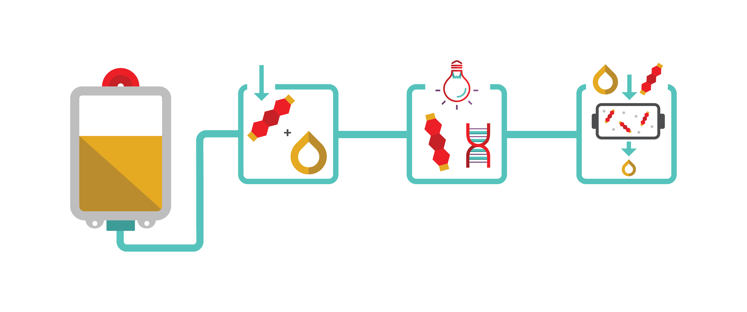

Background
INTERCEPT Blood System (Cerus) for pathogen inactivation reduces risk of:
Transfusion-transmitted infections
Adverse transfusion reactions
Initial INTERCEPT blood System technology was approved by Health Canada in 2016
AFP-PT was approved in August 2025!
Transfusion Medicine and Hemotherapy (2011): 38, 19-31; Transfusion (2020): 60, 1319-1331; Vox Sanguinis (2021): 116, 673-681.

Slide 5


Background
INTERCEPT treated platelets are now manufactured at all Canadian Blood Services manufacturing and distribution sites
Adverse event reporting related to platelet transfusions has decreased dramatically following implementation
Transfusion Medicine and Hemotherapy (2011): 38, 19-31; Transfusion (2020): 60, 1319-1331; Vox Sanguinis (2021): 116, 673-681.

Slide 6

Background
Canadian Blood Services increased access to Solvent detergent plasma in 2023
Treating plasma with Cerus’ INTERCEPT technology enhances the safety profile of this blood component
Transfusion Medicine and Hemotherapy (2011): 38, 19-31; Transfusion (2020): 60, 1319-1331; Vox Sanguinis (2021): 116, 673-681.

Slide 7
Pathogen inactivation technology (PIT)

Slide 8




Pathogen inactivation technology
    Canadian Blood Services has introduced Cerus INTERCEPT pathogen inactivation technology as an additional layer of safety against:
    Bacterial contaminants (gram-positive and gram negative)
    Viruses (enveloped and non-enveloped)
    Protozoa parasites
    White blood cells (leukocytes), which can no longer replicate

Slide 9
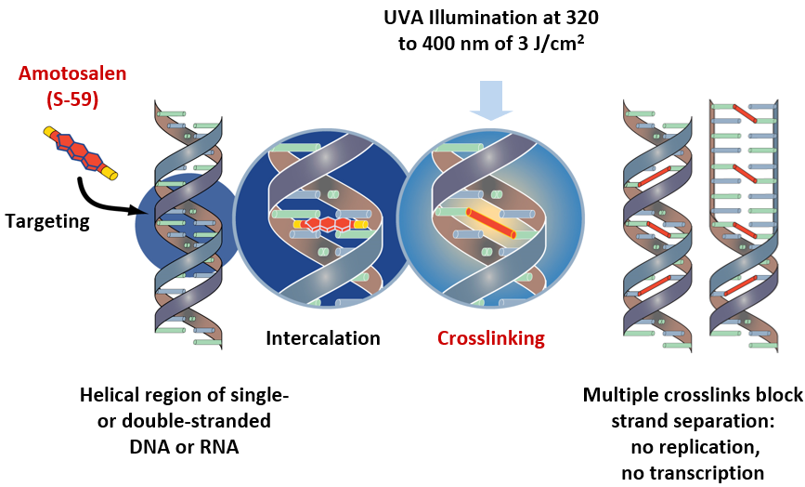
Mechanism of action (INTERCEPT)
1
2
3
4
Residual amotosalen is removed using a compound adsorption device
Source: Cerus. Intercept® Blood System for Plasma – Package insert. Concord, CA, Cerus Corporation, August 20, 2024. https://intercept-canada.com/
Notes:
Amotosalen is the active photoreactive compound of the Cerus INTERCEPT pathogen inactivation system. Amotosalen is a synthetic psoralen. Amotosalen is added to the component and intercalates within nucleic acids that compose the DNA and RNA of cells, bacteria, viruses and parasites. Amotosalen becomes activated when exposed to ultraviolet A illumination, causing permanent crosslinking between nucleic acid strands. This leads to DNA/RNA damage and inactivates cells and pathogens which may be present in a blood component (plasma or platelet). Any residual amotosalen is removed by a compound adsorption device.

Slide 10

Safety
Amotosalen safety profile
Toxicity extensively studied
Minimal residual amotosalen
In vitro, animal model, and European hemovigilance data suggest it is safe
Source: Cerus 2018 data on file
Notes:
The toxicity of psoralen-based treatments has been extensively studied in in vitro, in animal studies, and in clinical trials. The residual amotosalen amount after component preparation is minimal and falls well below toxic thresholds. It is important to highlight that while pathogen reduced component are relatively new to Canada, they have been routinely used in Europe since the mid-2000s.

Slide 11
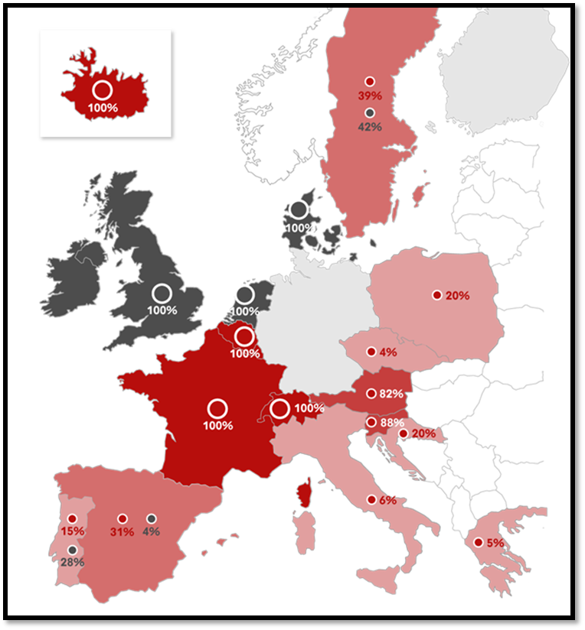
Safety
About INTERCEPT (provided by Cerus):
Commercialized for nearly 20 years
Adopted for the treatment of >50% of platelets produced in 10 Countries (including Canada)‡
Approx. 8.5 million INTERCEPT treated doses globally (plasma and platelets)*
Pathogen inactivated platelet concentrates
Platelet concentrates screened for bacteria
Platelet concentrates with neither bacterial screening nor pathogen inactivation
Source: Cerus 2018 data on file
‡Countries where INTERCEPT is standard of care, treating >50% of platelets
*Dose treated estimates for platelet and plasma based on the number of kits sold to date
Notes:
INTERCEPT has been commercialized for nearly 20 years, with approximately 8.5 million intercept treated products administered globally.
Large multinational hemovigilance databases have confirmed the excellent safety profile seen in the preclinical studies.

Slide 12

Manufacturing Process

Slide 13
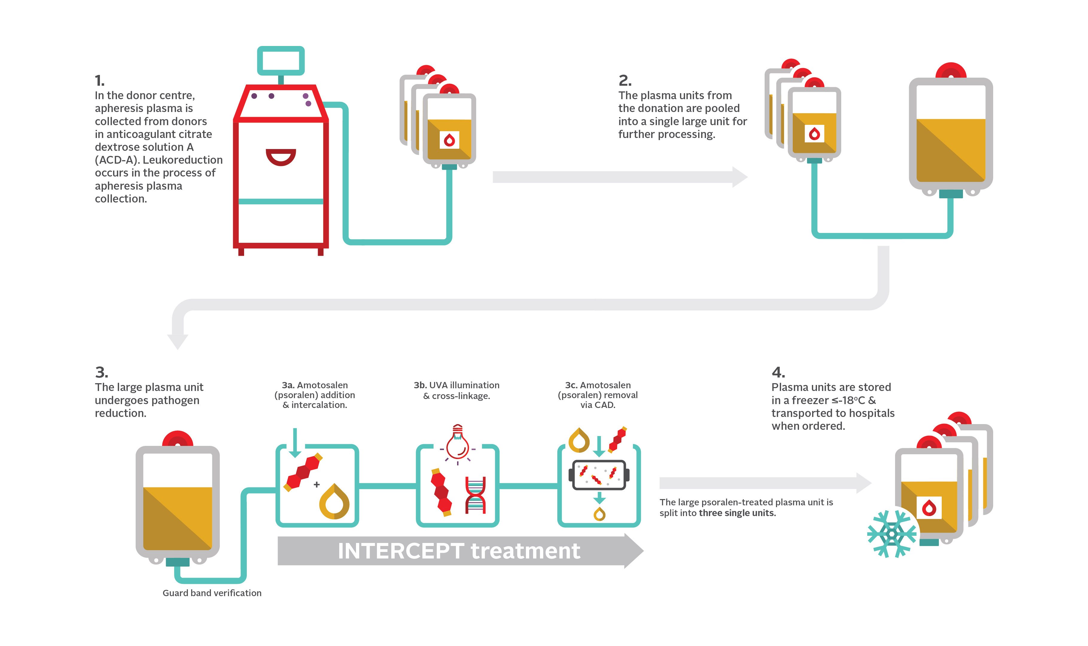
Manufacturing Process
Notes:
1. In the donor centre, apheresis plasma is collected from donors in acid citrate dextrose-solution A (ACD-A) anticoagulant. Leukoreduction occurs in the process of apheresis plasma collection.
2. The plasma units from the donation are pooled into a single large unit for further processing.
3. The large plasma unit undergoes pathogen reduction.
3a.In the INTERCEPT treatment, Amotosalen (psoralen) addition & intercalation
3b. UVA illumination & cross-linkage
3c. Amotosalen (psoralen) removal via CAD
4. The large psoralen-treated plasma unit is divided into three single units. Plasma units are stored in a freezer ≤-18°C and transported to hospitals when ordered.

Slide 14
Manufacturing Process: Step 1. Collection
ACD-A contains sodium citrate 22.0 g/L, citric acid 8.0 g/L, dextrose 24.5 g/L
May be collected from a donor with a history of pregnancy
Notes:
1. In the donor centre, apheresis plasma is collected from donors in acid citrate dextrose-solution A (ACD-A) anticoagulant. Leukoreduction occurs in the process of apheresis plasma collection.

Slide 15
Manufacturing Process: Step 2. Pooling
Notes:
2. The plasma units from the donation are pooled into a single large unit for further processing.

Slide 16
Manufacturing Process: Step 3. INTERCEPT Treatment
  Addition of 15 mL of 6 mM amotosalen solution (a synthetic psoralen)
  Illumination with 3 Joules/cm2 of UVA light (wavelength 320 to 400 nm)
  Compound adsorption device (CAD) for the removal of residual amotosalen and free photoproducts
Notes:
3. The large plasma unit undergoes pathogen reduction.
3a.In the INTERCEPT treatment, Amotosalen (psoralen) addition & intercalation
3b. UVA illumination & cross-linkage
3c. Amotosalen (psoralen) removal via CAD

Slide 17
Manufacturing Process: Step 4. Storage & Distribution
Stored in a ≤-18°C freezer within 24 hours of collection
Notes:
4. The large psoralen-treated plasma unit is divided into three single units. Plasma units are stored in a freezer ≤-18°C and transported to hospitals when ordered.

Slide 18

Apheresis frozen plasma, psoralen-treated
Volume: 203 mL ± 4 (SD) †; n = 90
Factor VIII : 1.17 IU/mL ± 0.26 (SD); n = 30
Typical unit content is based on the number of units (n) tested during validation from July 2024 to Aug 2024, inclusive.
†Volume includes approximately 35 mL of ACD-A anticoagulant; standard deviation (SD)

Slide 19

Efficacy & Safety

Slide 20

Comparable safety & efficacy to frozen plasma
Safety and efficacy of INTERCEPT treated plasma has been evaluated
in clinical trials.
Studies included patients with:
  congenital coagulopathies
  acquired coagulopathies
  therapeutic plasma exchange
  for thrombotic thrombocytopenic purpura (TTP)
P.D. Mintz, et al. Blood, 107 (2006); P.D. Mintz, et al. Transfusion, 46 (2006); de Alarcon, et al.Transfusion, 45 (2005); Cinqualbre, J., et al. (2015), Transfusion, 55: 1710-1720.

Slide 21
Comparable safety & efficacy to frozen plasma
Double-blinded, randomized controlled trial (USA)
n = 121, aged 2 years or older with acquired coagulopathy requiring therapeutic or prophylactic plasma transfusion with indication for an invasive procedure or reversal of warfarin therapy
Randomized to standard plasma or plasma that had undergone photochemical treatment process using a synthetic psoralen
  No differences were observed in use of blood components, clinical hemostasis, or safety.
P.D. Mintz, et al. Blood, 107 (2006); P.D. Mintz, et al. Transfusion, 46 (2006); de Alarcon, et al.Transfusion, 45 (2005)

Slide 22

Comparable safety & efficacy to frozen plasma
Retrospective study comparing therapeutic efficacy & safety outcomes (i.e., acute hepatic artery thrombosis and mortality) in patients receiving a liver transplant
n = 418 patients
212 transplants supported with standard plasma
215 transplants supported with amotosalen-UVA pathogen inactivated plasma
No significant differences were observed in blood component utilization or safety outcomes
Cinqualbre, J., et al. (2015), Transfusion, 55: 1710-1720.

Slide 23


Comparable safety & efficacy to frozen plasma
The results of these studies suggest that psoralen-treated plasma was able to effectively support hemostasis similarly to conventional plasma.
P.D. Mintz, et al. Blood, 107 (2006); P.D. Mintz, et al. Transfusion, 46 (2006); de Alarcon, et al.Transfusion, 45 (2005); Cinqualbre, J., et al. (2015), Transfusion, 55: 1710-1720.

Slide 24
Safety & adverse transfusion reaction rates
Adverse transfusion reaction rate was 0.06% in Ontario in 2022
Prior to the increase in access to S/D plasma
Reported by 159 Ontario hospitals to the Transfusion Transmitted Injury Surveillance System out of 40,873 untreated frozen plasma transfusions
Internal data from Canadian Blood Services
Occurrence of ATR events following psoralen-treated plasma transfusion was approximately 0.1% of transfusions or 0.04% of psoralen-treated plasma components
Nour Alhomsi, Melanie St John, Andrew W. Shih, Matthew TS Yan, Maheen Ahmad, Marianne Waito, Michelle P Zeller, Kathryn Webert. Impact on Solvent Detergent Plasma Implementation on Adverse Transfusion Reaction Reporting. Poster CSTM (NFLD 2025)

Slide 25
Safety & adverse transfusion reaction rates
Hemovigilance data from France and Belgium reported a rate of 0.34 events per 1000 transfused plasma components (or 0.034%)
No TRALI episodes were reported in 7483 transfusions of 19,069 psoralen-treated plasma units
Active hemovigilance reporting performed in several centers showed lower adverse events reported per year in INTERCEPT treated plasma compared to other types of transfused plasma.
In 2009 there were 12 reported adverse transfusion reactions with INTERCEPT treated plasma (22,933 components) compared to 191 in other types of plasma (348,725 components) with comparable results in 2010 and 2011.
Cazenave JP, et al. Transfusion 2009;50(6); Irsch J and J Seghatchian. Transfusion and Apheresis Science 2015;52(2)

Slide 26
Plasma quality comparison (preliminary data)
Comparison of day 0 post-thaw plasma in vitro quality plasma
Parameter | Untreated non-O multi-plasma (n = 15) † | INTERCEPT treated non-O multi-plasma (n = 33) †‡ | Octaplasma (n = 12) § |  |  |  |  | Laboratory clinical reference range, 95% CI||
 | Mean ± standard deviation (SD) | Mean ± SD | mean | min |  |  | max
FVIII (IU/mL) ¶ | 1.36 ± 0.31 | 0.83 ± 0.18 | 1.08** |  | 0.80 | 1.30 |  | 0.50–1.49
FVII (IU/mL) | 1.13 ± 0.26 | 0.87 ± 0.19 | 1.08 | 0.90 |  |  | 1.17 | 0.45–1.33
FV (IU/mL) | 0.94 ± 0.11 | 1.01 ± 0.21 | 0.78 | 0.75 |  |  | 0.84 | 0.66–1.02
Fibrinogen (g/L) | 3.09 ± 0.51 | 2.53 ± 0.56 | 2.50 | 2.40 |  |  | 2.60 | 1.70–4.10
Prothrombin time (s) | 14.00 ± 0.50 | 15.10 ± 0.80 | No data |  |  |  |  | 10.40–12.30
Protein S activity (IU/mL) | 1.02 ± 0.18 | 0.83 ± 0.15 | 0.64 | 0.55 |  |  | 0.71 | 0.55–1.43
Alpha-2 antiplasmin (IU/mL) | 1.20 ± 0.14 | 1.02 ± 0.12 | 0.23 | 0.20 |  |  | 0.27 | 0.68–1.36
ADAMTS-13 (IU/mL) | 0.78 ± 0.18 | 0.93 ± 0.12 | 1.01 ± 0.08 (mean ± SD) |  |  |  |  | 40%–130%#
†Alpha-2 antiplasmin and ADAMTS-13 were determined using kits designed for research purposes. The other parameters were tested on Stago Coagulation Analyzer. All methods are designed for clinical diagnostic samples; however, we are using them “off label” to measure coagulation related parameters in plasma components (n = 33 for all the parameters).
‡Data were gathered from development data at Canadian Blood Services.
§All parameters taken from product monograph (n = 12), except for ADAMTS-13 (n =18) taken from https://www.octaplasma.ca/standardization-of-plasma-protein-levels-in-octaplasma/
||There are currently no defined acceptance criteria listed by CSAZ902-25 specifically for pathogen reduced plasma.
¶Reference ranges were taken from Erickson et al. and were established on fresh frozen, normal donor plasma samples by Machaon Diagnostic Laboratory
#The percentage of activity and the IU/mL unit are directly proportional (i.e., if the activity is 50%, it would be 0.5 IU/mL).
**Heger et al. data
CSA Group. (2025). CAN/CSA-Z902:25 Blood and blood components; Octapharma Canada. (2022). Octaplasma Product Monograph; Erickson, A., et al. (2017).Transfusion, 57(4), 997-1006. Heger A, Gruber G. Transfusion. 2022 Dec;62(12):2621-2630.
Notes:
Table shows a comparison of factor levels across standard frozen plasma, solvent detergent plasma and INTERCEPT treated plasma. All coagulation factors fall within normal laboratory clinical reference ranges.

Slide 27

Indications, contraindications
& dosing

Slide 28







Indications for AFP-PT
May be useful in patients who are:
Bleeding or undergoing invasive procedures with a high-risk of bleeding possibly requiring replacement of multiple plasma coagulation factors
Requiring reconstituted whole blood for exchange transfusion in neonates
Being treated for thrombotic thrombocytopenic purpura (TTP) or hemolytic uremic syndrome (HUS) undergoing plasma exchange
Receiving massive transfusion with clinically significant coagulation abnormalities
Known to have selected coagulation factor or with rare specific plasma protein deficiencies for which a more appropriate alternative therapy is not available
On warfarin and are bleeding or need to undergo an invasive procedure with a high-risk of bleeding before vitamin K can reverse the warfarin effect, and where prothrombin complex concentrate is not available or is contraindicated
Bloody Easy 5.1, JACC. 2020 Aug, 76 (5) 594–622, AJH 2019 March, 94(6) 697-709, Br J Haematol, 181: 54-67.

Slide 29





Contraindications for AFP-PT
Contraindicated in patients with:
Known anaphylaxis to plasma components should only receive plasma components under appropriate medical supervision
A history of hypersensitivity reactions to amotosalen or other psoralens
Neonatal patients treated with phototherapy devices that emits a peak energy wavelength <425 nm, and/or have a lower bound of the emission bandwidth <375 nm, due to the potential for erythema resulting from interaction between ultraviolet light and amotosalen
Known anti-IgA should receive IgA deficient plasma
Plasma components should not be used to treat hypovolemia

Slide 30

Selected Populations

Slide 31
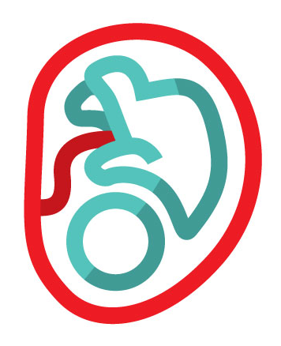


Neonatal, pediatrics, and
intrauterine transfusions
There are limited safety data for AFP-PT and intrauterine transfusions
Clinical trials have reported no or low-grade adverse events in pediatric and neonatal patients
Transfusion, 2010: 50(6), 1210-1219; Vox Sang, 2013, 105, 282-283.

Slide 32
Neonatal, pediatrics, and
intrauterine transfusions
Open label clinical trial in Belgium and France reported pathogen-reduced plasma transfusions were well tolerated in children and infants
Hemovigilance study (11 countries over 8 years) reported infrequent transfusion reactions (0.4% of transfusions).
  n = 440 infants (aged < 1 years)
  n = 355 children (aged 1–18 years)
Transfusion, 2010: 50(6), 1210-1219; Vox Sang, 2013, 105, 282-283.

Slide 33
Neonatal, pediatrics, and
intrauterine transfusions
Post-marketing hemovigilance study
(3,179 pathogen-reduced plasma and platelet transfusions)
  Well tolerated by a pediatric population with only low-grade transfusion reactions reported.
  n = 540 children (aged 1–18 years)
  n = 499 infants (aged < 1 year) with mixed clinical indications
  3 out of 795 pediatric patients experienced a transfusion reaction without serious consequences:
    rash (n = 2)
    urticaria (n = 1)
    chills (n = 1)
Transfusion, 2010: 50(6), 1210-1219; Vox Sang, 2013, 105, 282-283.

Slide 34

Pregnant individuals
There are no studies that have specifically addressed use of INTERCEPT-treated, pathogen-reduced plasma in pregnant people
Nonclinical studies in reproductive animal models have been conducted
Administration of photochemically treated plasma did not cause maternal or fetal developmental toxicity in these studies
Ciaravino, V., et al. (2003), Vox Sanguinis

Slide 35

Hospital considerations & resources

Slide 36

Anticipated implementation timeline for AFP-PT
Health Canada approval received Aug 2025
Phased implementation beginning in Ottawa in September 2025
Please consult our most recent customer letter on implementation or reach out to your local Hospital Liaison Specialist for details and timelines

Slide 37

Hospital implementation considerations
Hospital IT:
Add new ISBT Component Codes to LIS
Proportion of inventory requested by the hospital for S/D plasma will not be impacted.
Initial implementation will see AFP-PT introduced into hospital requested AFP (untreated) inventory and cannot be specifically ordered due to limited AFP-PT availability.
Laboratory information systems (LIS)

Slide 38
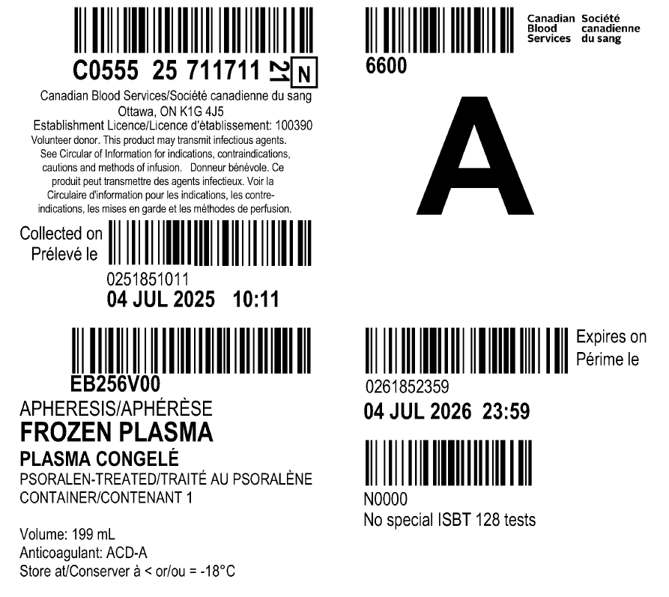
Hospital implementation considerations
ISBT 128 donation number
ISBT 128 blood group code
C#### ## ######
N
##
ABO blood group
Collection date and time
ISBT 128 product code
Expiration date and time
Component description
Visit blood.ca to find a list of the new codes in customer letter # 2025-26

Slide 39
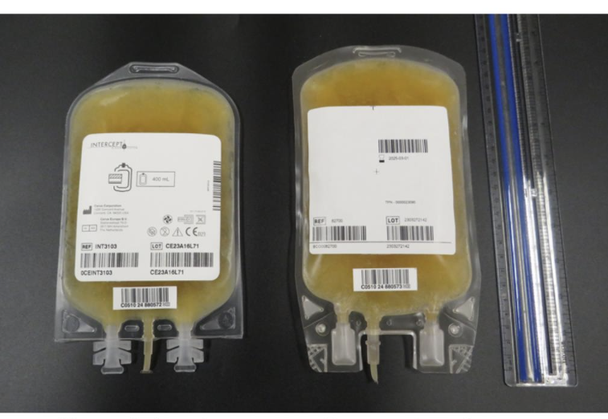
Visual Appearance - Frozen
Apheresis Frozen Plasma Psoralen Treated
Apheresis Frozen Plasma (untreated)

Slide 40
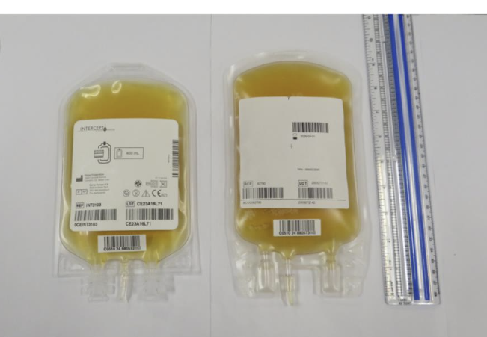
Visual Appearance - Thawed
Apheresis Frozen Plasma Psoralen Treated
Apheresis Frozen Plasma (untreated)

Slide 41
Hospital implementation considerations
Administration of product
Assess/revise transfusion policies
Patient and nurse education
Example materials (bag & label) can be provided upon request by contacting your Canadian Blood Services Hospital Liaison Specialist
See the new Circular of Information on blood.ca

Slide 42
Storage & administration
Stored at ≤ -18°C for a maximum of 12 months
Should be thawed in a watertight protective plastic overwrap using gentle agitation in a water bath at 30 to 37°C; can take up to 30 minutes
Once thawed, component should not be refrozen
If stored at 1 to 6°C, the component should be transfused within 5-days
Visual inspection of the component should be performed (see Visual Inspection Tool)

Slide 43

Additional resources

Slide 44

Resources
New Circular of Information
Educational resources can be found on Canadian Blood Services’ professional education website, Profedu.ca
Publication
Slide deck (also available as a narrated video)
Clinical Highlights slide deck (also available as a narrated video)
FAQ: Information for health professionals
INTERCEPT package insert: intercept-canada.com
Notes:
To point out:
If surfing on Web, beware of different regulatory requirements applicable depending on jurisdictions.

Slide 45

Contact

Slide 46

Contact
Please contact your local Hospital Liaison Specialist with any questions

Slide 47
Together, we are Canada’s Lifeline

