Slide 1
Apheresis frozen plasma, psoralen-treated:
Clinical Highlights
Canadian Blood Services Medical Services and Hospital Relations
August 2025

Slide 2
Acronyms
Acronym | Name
AFP-PT | Apheresis frozen plasma, psoralen-treated
AFP | Apheresis frozen plasma
PIT | Pathogen inactivation technology
PRT | Pathogen reduction technology
ATR | Adverse transfusion reaction
S/D plasma | Solvent detergent plasma

Slide 3
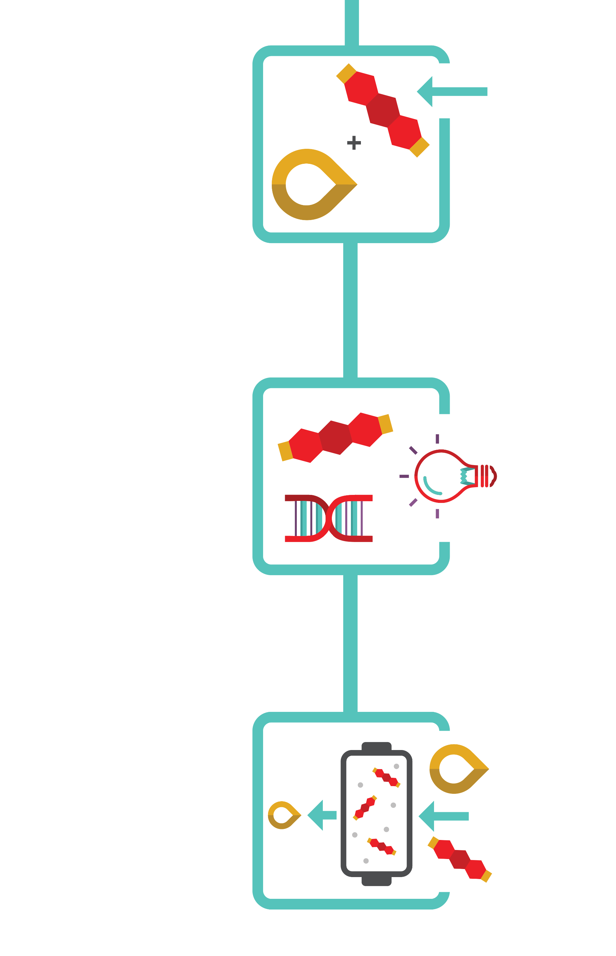

Background
INTERCEPT Blood System (Cerus) for pathogen inactivation reduces risk of:
Transfusion-transmitted infections
Adverse transfusion reactions
Initial INTERCEPT blood System technology was approved by Health Canada in 2016
AFP-PT was approved in August 2025!
Transfusion Medicine and Hemotherapy (2011): 38, 19-31; Transfusion (2020): 60, 1319-1331; Vox Sanguinis (2021): 116, 673-681.
Notes:
INTERCEPT Blood System (Cerus Corporation) for pathogen inactivation reduces the risk of transfusion-transmitted infections & adverse transfusion reactions
Approved by Health Canada in 2016

Slide 4


Background
INTERCEPT treated platelets are now manufactured at all Canadian Blood Services manufacturing and distribution sites
Adverse event reporting related to platelet transfusions has decreased dramatically following implementation
Transfusion Medicine and Hemotherapy (2011): 38, 19-31; Transfusion (2020): 60, 1319-1331; Vox Sanguinis (2021): 116, 673-681.
Notes:
INTERCEPT treated platelets are now manufactured across all Canadian Blood Services manufacturing and distribution sites
Adverse event reporting related to platelet transfusions has decreased dramatically following implementation.

Slide 5




Pathogen inactivation technology
    Canadian Blood Services has introduced Cerus INTERCEPT pathogen inactivation technology as an additional layer of safety against:
    Bacterial contaminants (gram-positive and gram negative)
    Viruses (enveloped and non-enveloped)
    Protozoa parasites
    White blood cells (leukocytes), which can no longer replicate

Slide 6
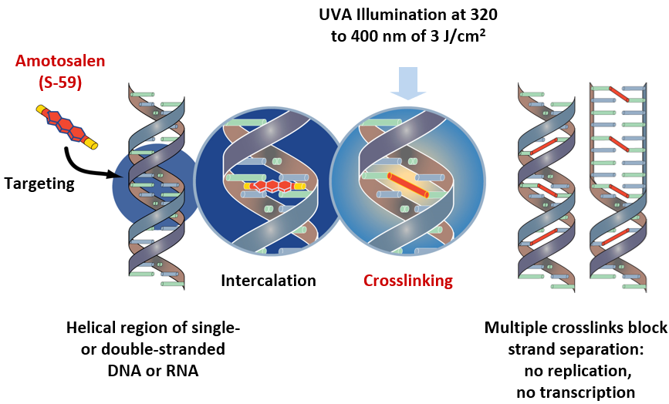
Mechanism of action (INTERCEPT)
1
2
3
4
Residual amotosalen is removed using a compound adsorption device
Source: Cerus. Intercept® Blood System for Plasma – Package insert. Concord, CA, Cerus Corporation, August 20, 2024. https://intercept-canada.com/
Notes:
Amotosalen is the active photoreactive compound of the Cerus INTERCEPT pathogen inactivation system. Amotosalen is a synthetic psoralen. Amotosalen is added to the component and intercalates within nucleic acids that compose the DNA and RNA of cells, bacteria, viruses and parasites. Amotosalen becomes activated when exposed to ultraviolet A illumination, causing permanent crosslinking between nucleic acid strands. This leads to DNA/RNA damage and inactivates cells and pathogens which may be present in a blood component (plasma or platelet). Any residual amotosalen is removed by a compound adsorption device.

Slide 7

Safety
Amotosalen safety profile
Toxicity extensively studied
Minimal residual amotosalen
In vitro, animal model, and European hemovigilance data suggest it is safe
Source: Cerus 2018 data on file
Notes:
The toxicity of psoralen-based treatments has been extensively studied in in vitro, in animal studies, and in clinical trials. The residual amotosalen amount after preparation is minimal and falls well below toxic thresholds. It is important to highlight that while pathogen reduced components are new to Canada, they have been routinely used in Europe since the mid-2000s.

Slide 8
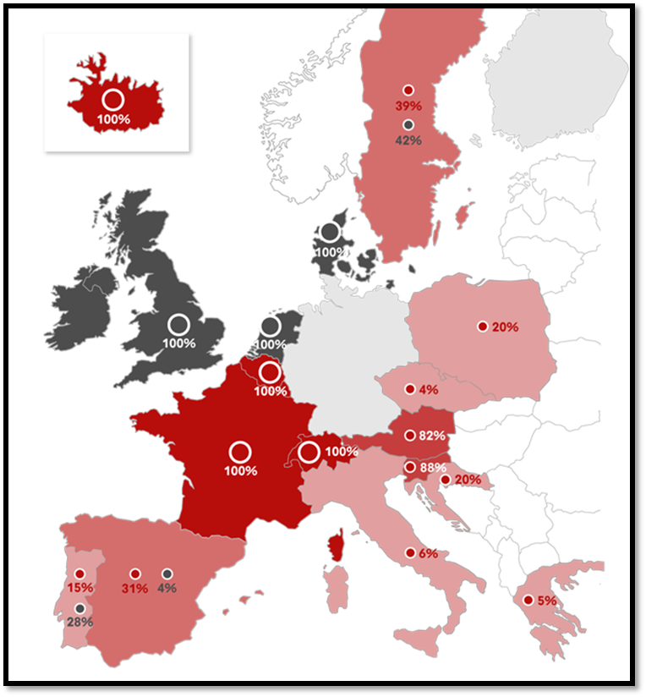
Safety
About INTERCEPT (provided by Cerus):
Commercialized for nearly 20 years
Adopted for the treatment of >50% of platelets produced in 10 Countries (including Canada)‡
Approx. 8.5 million INTERCEPT treated doses globally (plasma and platelets)*
Pathogen inactivated platelet concentrates
Platelet concentrates screened for bacteria
Platelet concentrates with neither bacterial screening nor pathogen inactivation
Source: Cerus 2018 data on file
‡Countries where INTERCEPT is standard of care, treating >50% of platelets
*Dose treated estimates for platelet and plasma based on the number of kits sold to date
Notes:
INTERCEPT has been commercialized for nearly 20 years, with approximately 8.5 million intercept treated products administered globally.
Large multinational hemovigilance databases have confirmed the excellent safety profile seen in the preclinical studies.
The toxicity of psoralen-based treatments has been extensively studied in in vitro, in animal studies, and in clinical trials. The residual amotosalen amount after preparation is minimal and falls well below toxic thresholds. It is important to highlight that while pathogen reduced components are newish to Canada, they have been routinely used in Europe since the mid-2000s. INTERCEPT has been commercialized for nearly 20 years, with approximately 8.5 million intercept treated products administered globally. Large multinational hemovigilance databases have confirmed the excellent safety profile seen in the preclinical studies .

Slide 9
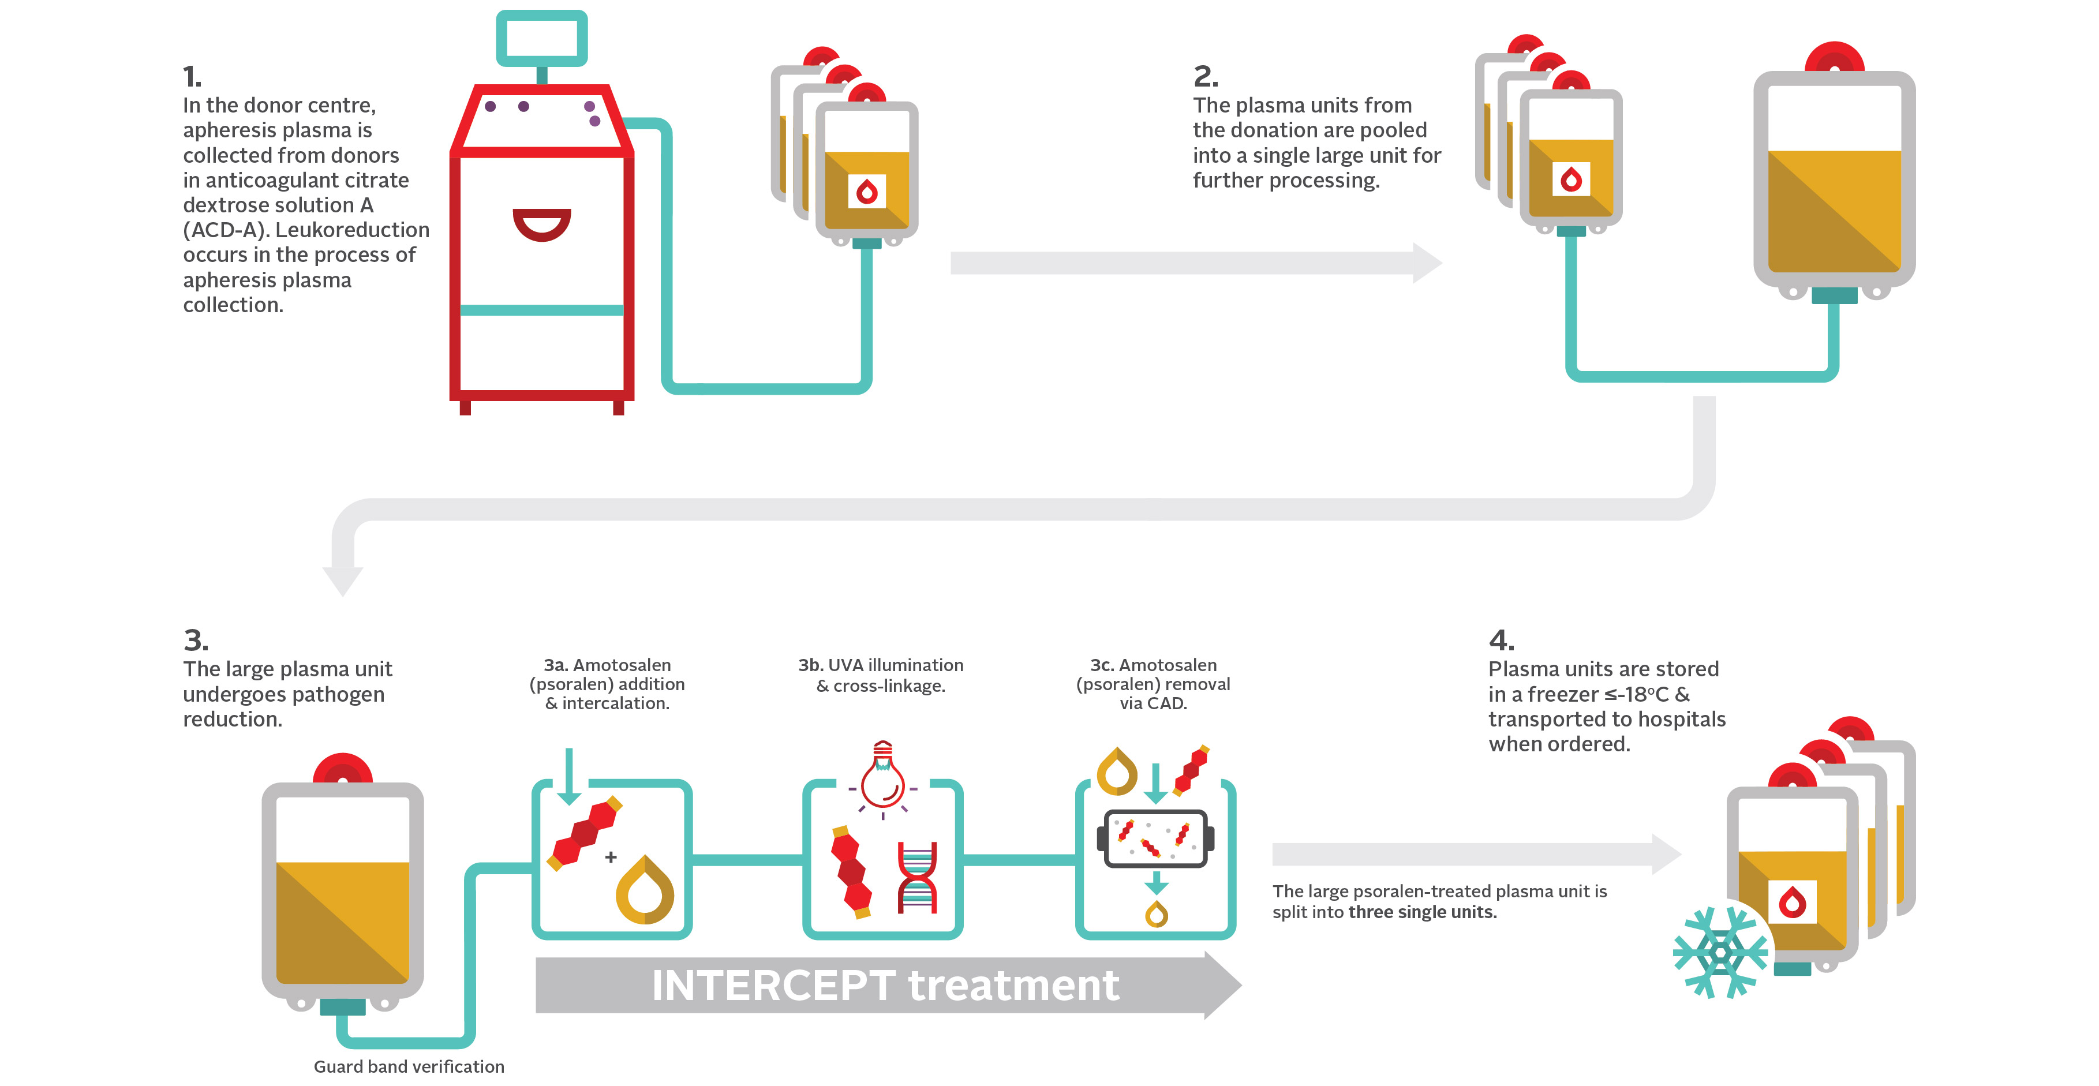
Manufacturing Process
Notes:
1. In the donor centre, apheresis plasma is collected from donors in acid citrate dextrose-solution A (ACD-A) anticoagulant. Leukoreduction occurs in the process of apheresis plasma collection.
2. The plasma units from the donation are pooled into a single large unit for further processing.
3. The large plasma unit undergoes pathogen reduction.
3a.In the INTERCEPT treatment, Amotosalen (psoralen) addition & intercalation
3b. UVA illumination & cross-linkage
3c. Amotosalen (psoralen) removal via CAD
4. The large psoralen-treated plasma unit is divided into three single units. Plasma units are stored in a freezer ≤-18°C and transported to hospitals when ordered.

Slide 10

Apheresis frozen plasma, psoralen-treated
Volume: 203 mL ± 4 (SD) †; n = 90
Factor VIII : 1.17 IU/mL ± 0.26 (SD); n = 30
Typical unit content is based on the number of units (n) tested during validation from July 2024 to Aug 2024, inclusive.
†Volume includes approximately 35 mL of ACD-A anticoagulant; standard deviation (SD)

Slide 11

Comparable safety & efficacy to frozen plasma
Safety and efficacy of INTERCEPT treated plasma has been evaluated
in clinical trials.
Studies included patients with:
  congenital coagulopathies
  acquired coagulopathies
  therapeutic plasma exchange
  for thrombotic thrombocytopenic purpura (TTP)
P.D. Mintz, et al. Blood, 107 (2006); P.D. Mintz, et al. Transfusion, 46 (2006); de Alarcon, et al.Transfusion, 45 (2005); Cinqualbre, J., et al. (2015), Transfusion, 55: 1710-1720.

Slide 12


Comparable safety & efficacy to frozen plasma
The results of these studies suggest that psoralen-treated plasma was able to effectively support hemostasis similarly to conventional plasma.
P.D. Mintz, et al. Blood, 107 (2006); P.D. Mintz, et al. Transfusion, 46 (2006); de Alarcon, et al.Transfusion, 45 (2005); Cinqualbre, J., et al. (2015), Transfusion, 55: 1710-1720.
Notes:
The results of these studies suggest that psoralen-treated plasma was able to effectively support hemostasis similarly to conventional plasma.

Slide 13
Safety & adverse transfusion reaction rates
Hemovigilance data from France and Belgium reported a rate of 0.34 events per 1000 transfused plasma components (or 0.034%)
No TRALI episodes were reported in 7483 transfusions of 19,069 psoralen-treated plasma units
Active hemovigilance reporting performed in several centers showed lower adverse events reported per year in INTERCEPT treated plasma compared to other types of transfused plasma.
In 2009 there were 12 reported adverse transfusion reactions with INTERCEPT treated plasma (22,933 components) compared to 191 in other types of plasma (348,725 components) with comparable results in 2010 and 2011.
Cazenave JP, et al. Transfusion 2009;50(6); Irsch J and J Seghatchian. Transfusion and Apheresis Science 2015;52(2)

Slide 14
Plasma quality comparison (preliminary data)
Comparison of day 0 post-thaw plasma in vitro quality plasma
Parameter | Untreated non-O multi-plasma (n = 15) † | INTERCEPT treated non-O multi-plasma (n = 33) †‡ | Octaplasma (n = 12) § |  |  |  |  | Laboratory clinical reference range, 95% CI||
 | Mean ± standard deviation (SD) | Mean ± SD | mean | min |  |  | max
FVIII (IU/mL) ¶ | 1.36 ± 0.31 | 0.83 ± 0.18 | 1.08** |  | 0.80 | 1.30 |  | 0.50–1.49
FVII (IU/mL) | 1.13 ± 0.26 | 0.87 ± 0.19 | 1.08 | 0.90 |  |  | 1.17 | 0.45–1.33
FV (IU/mL) | 0.94 ± 0.11 | 1.01 ± 0.21 | 0.78 | 0.75 |  |  | 0.84 | 0.66–1.02
Fibrinogen (g/L) | 3.09 ± 0.51 | 2.53 ± 0.56 | 2.50 | 2.40 |  |  | 2.60 | 1.70–4.10
Prothrombin time (s) | 14.00 ± 0.50 | 15.10 ± 0.80 | No data |  |  |  |  | 10.40–12.30
Protein S activity (IU/mL) | 1.02 ± 0.18 | 0.83 ± 0.15 | 0.64 | 0.55 |  |  | 0.71 | 0.55–1.43
Alpha-2 antiplasmin (IU/mL) | 1.20 ± 0.14 | 1.02 ± 0.12 | 0.23 | 0.20 |  |  | 0.27 | 0.68–1.36
ADAMTS-13 (IU/mL) | 0.78 ± 0.18 | 0.93 ± 0.12 | 1.01 ± 0.08 (mean ± SD) |  |  |  |  | 40%–130%#
†Alpha-2 antiplasmin and ADAMTS-13 were determined using kits designed for research purposes. The other parameters were tested on Stago Coagulation Analyzer. All methods are designed for clinical diagnostic samples; however, we are using them “off label” to measure coagulation related parameters in plasma components (n = 33 for all the parameters).
‡Data were gathered from development data at Canadian Blood Services.
§All parameters taken from product monograph (n = 12), except for ADAMTS-13 (n =18) taken from https://www.octaplasma.ca/standardization-of-plasma-protein-levels-in-octaplasma/
||There are currently no defined acceptance criteria listed by CSAZ902-25 specifically for pathogen reduced plasma.
¶Reference ranges were taken from Erickson et al. and were established on fresh frozen, normal donor plasma samples by Machaon Diagnostic Laboratory
#The percentage of activity and the IU/mL unit are directly proportional (i.e., if the activity is 50%, it would be 0.5 IU/mL).
**Heger et al. data
CSA Group. (2025). CAN/CSA-Z902:25 Blood and blood components; Octapharma Canada. (2022). Octaplasma Product Monograph; Erickson, A., et al. (2017).Transfusion, 57(4), 997-1006. Heger A, Gruber G. Transfusion. 2022 Dec;62(12):2621-2630.
Notes:
Table shows a comparison of factor levels across standard frozen plasma, solvent detergent plasma and INTERCEPT treated plasma. All coagulation factors fall within normal laboratory clinical reference ranges.

Slide 15







Indications for AFP-PT
May be useful in patients who are:
Bleeding or undergoing invasive procedures with a high-risk of bleeding possibly requiring replacement of multiple plasma coagulation factors
Requiring reconstituted whole blood for exchange transfusion in neonates
Being treated for thrombotic thrombocytopenic purpura (TTP) or hemolytic uremic syndrome (HUS) undergoing plasma exchange
Receiving massive transfusion with clinically significant coagulation abnormalities
Known to have selected coagulation factor or with rare specific plasma protein deficiencies for which a more appropriate alternative therapy is not available
On warfarin and are bleeding or need to undergo an invasive procedure with a high-risk of bleeding before vitamin K can reverse the warfarin effect, and where prothrombin complex concentrate is not available or is contraindicated
Bloody Easy 5.1, JACC. 2020 Aug, 76 (5) 594–622, AJH 2019 March, 94(6) 697-709, Br J Haematol, 181: 54-67.
Notes:
AFP-PT may be useful in the management of patients who are:
Bleeding or undergoing invasive procedures with high bleeding risk who require replacement of multiple plasma coagulation factors
Receiving massive transfusion with clinically significant coagulation abnormalities,
Known to have selected coagulation factor or with rare specific plasmaprotein deficiencies for which a more appropriate alternative therapy is notavailable
Requiring reconstituted whole blood for exchange transfusion in neonates
Being treated for thrombotic thrombocytopenic purpura (TTP) or hemolyticuremic syndrome (HUS) undergoing plasma exchange
On warfarin who are bleeding or need to undergo a high bleeding risk invasiveprocedure before vitamin K could reverse the warfarin effect, and where prothrombin complex concentrate is not available or is contraindicated

Slide 16





Contraindications for AFP-PT
Contraindicated in patients with:
Known anaphylaxis to plasma components should only receive plasma components under appropriate medical supervision
A history of hypersensitivity reactions to amotosalen or other psoralens
Neonatal patients treated with phototherapy devices that emits a peak energy wavelength <425 nm, and/or have a lower bound of the emission bandwidth <375 nm, due to the potential for erythema resulting from interaction between ultraviolet light and amotosalen
Known anti-IgA should receive IgA deficient plasma
Plasma components should not be used to treat hypovolemia
Notes:
Patients with known anaphylaxis to plasma components should only receive plasma components under appropriate medical supervision.
Recipients with known anti-IgA should receive IgA deficient plasma.
Plasma components should not be used to treat hypovolemia.
AFP-PT should not be used for:
Patients with a history of hypersensitivity reaction to amotosalen or other psoralens.
Neonatal patients treated with phototherapy devices that emit a peak energy wavelength less than 425 nm, and / or have a lower bound of the emission bandwidth <375 nm, due to the potential for erythema resulting from interaction between ultraviolet light and amotosalen.

Slide 17
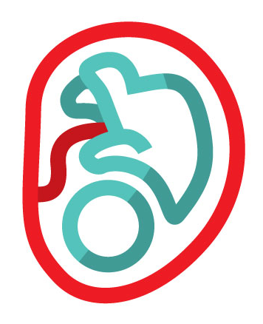


Neonatal, pediatrics, and
intrauterine transfusions
There are limited safety data for AFP-PT and intrauterine transfusions
Clinical trials have reported no or low-grade adverse events in pediatric and neonatal patients
Transfusion, 2010: 50(6), 1210-1219; Vox Sang, 2013, 105, 282-283.
Notes:
Currently, there are limited safety data for AFPPT in IUT
Clinical trials reported no or low-grade adverse events in pediatric and neonatal patients

Slide 18
Neonatal, pediatrics, and
intrauterine transfusions
Post-marketing hemovigilance study
(3,179 pathogen-reduced plasma and platelet transfusions)
  Well tolerated by a pediatric population with only low-grade transfusion reactions reported.
  n = 540 children (aged 1–18 years)
  n = 499 infants (aged < 1 year) with mixed clinical indications
  3 out of 795 pediatric patients experienced a transfusion reaction without serious consequences:
    rash (n = 2)
    urticaria (n = 1)
    chills (n = 1)
Transfusion, 2010: 50(6), 1210-1219; Vox Sang, 2013, 105, 282-283.
Notes:
Post-marketing hemovigilance study (3,179 PR plasma and platelet transfusions)
Well tolerated by a pediatric population with only low-grade transfusion reactions reported.
540 children (aged 1–18 years) and 499 infants (aged < 1 year) with mixed clinical indications
3/795 pediatric patients experienced a transfusion reaction: rash (n=2), urticaria (n=1), and chills (n=1) without serious consequences.

Slide 19

Pregnant individuals
There are no studies that have specifically addressed use of INTERCEPT-treated, pathogen-reduced plasma in pregnant people
Nonclinical studies in reproductive animal models have been conducted
Administration of photochemically treated plasma did not cause maternal or fetal developmental toxicity in these studies
Ciaravino, V., et al. (2003), Vox Sanguinis

Slide 20
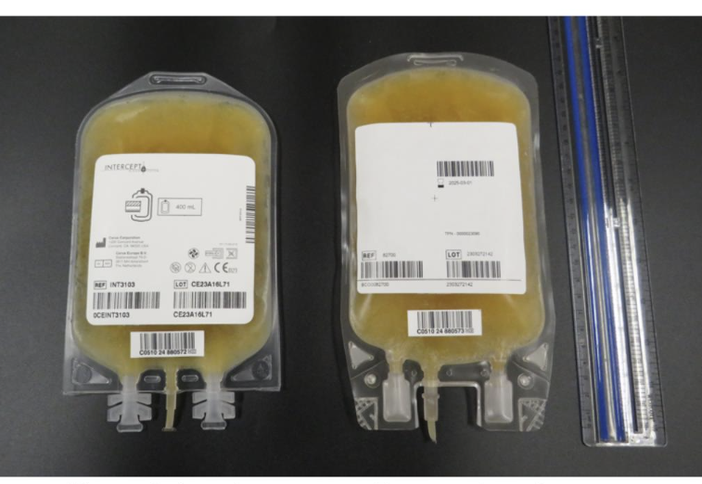
Visual Appearance - Frozen
Apheresis Frozen Plasma Psoralen Treated
Apheresis Frozen Plasma (untreated)
###############
###############

Slide 21
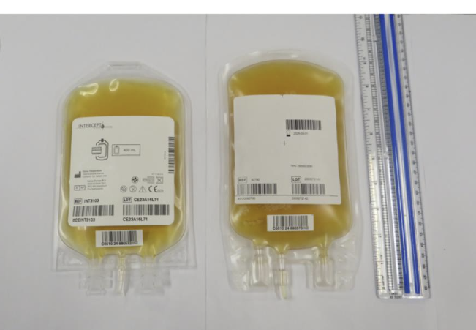
Visual Appearance - Thawed
Apheresis Frozen Plasma Psoralen Treated
Apheresis Frozen Plasma (untreated)
###############
###############

Slide 22
Storage & administration
Stored at ≤ -18°C for a maximum of 12 months
Should be thawed in a watertight protective plastic overwrap using gentle agitation in a water bath at 30 to 37°C; can take up to 30 minutes
Once thawed, component should not be refrozen
If stored at 1 to 6°C, the component should be transfused within 5-days
Visual inspection of the component should be performed (see Visual Inspection Tool)

Slide 23

Resources
New Circular of Information
Educational resources can be found on Canadian Blood Services’ professional education website, Profedu.ca
Publication
Slide deck (also available as a narrated video)
Clinical Highlights slide deck (also available as a narrated video)
FAQ: Information for health professionals
INTERCEPT package insert: intercept-canada.com
Notes:
To point out:
If surfing on Web, beware of different regulatory requirements applicable depending on jurisdictions.

Slide 24
Together, we are Canada’s Lifeline

