Slide 1

Karkouti K, Callum JL, Bartoszko J, et al; FARES-II Study Group
Prothrombin Complex Concentrate vs Frozen Plasma for Coagulopathic Bleeding in Cardiac Surgery
The FARES-II Multicenter Randomized Clinical Trial
Published online March 29, 2025
American College of Cardiology Annual Scientific Session (ACC.25)

Slide 2
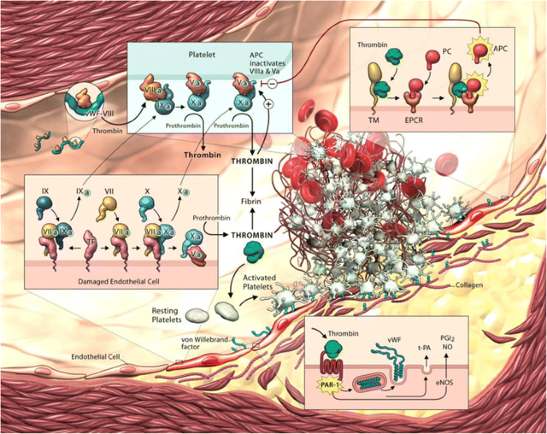
Coagulopathic Bleeding
Yau BMC Cardiovascular Disorders. 2015;15:130

Slide 3
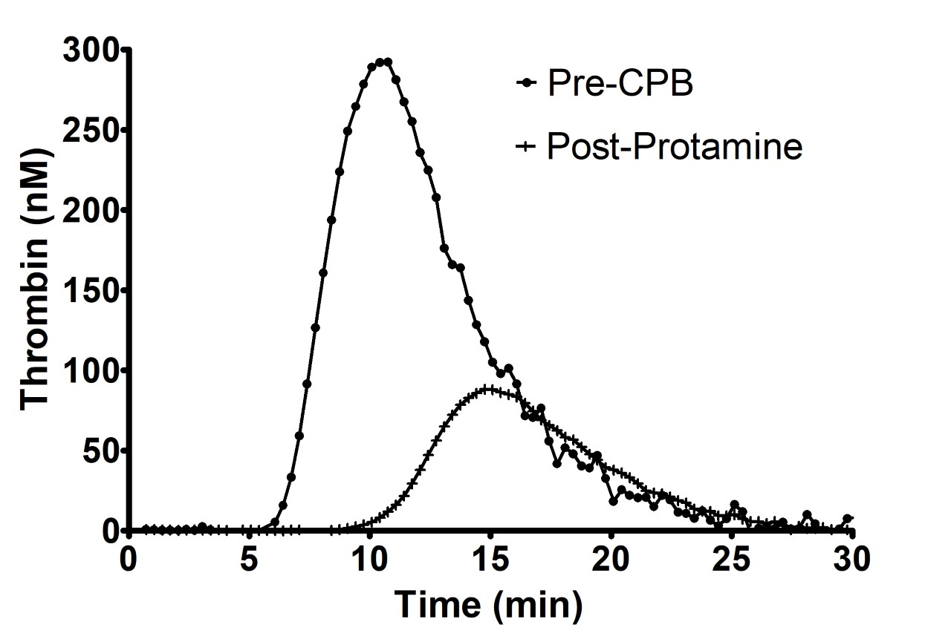
Impaired Thrombin Generation
Bartoszko et al. BJA 2021 Under Review

Slide 4
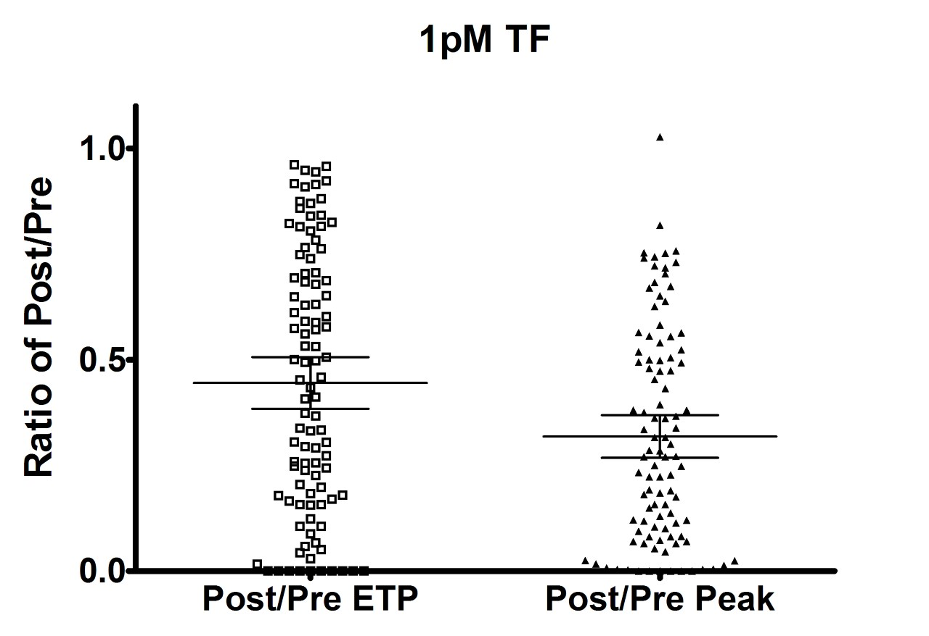
Impaired Thrombin Generation
Bartoszko et al. BJA 2021 Under Review

Slide 5
Impaired Thrombin Generation after CVS
Percy et al. Blood Coag Fibrinol 2015;26:357-367

Slide 6
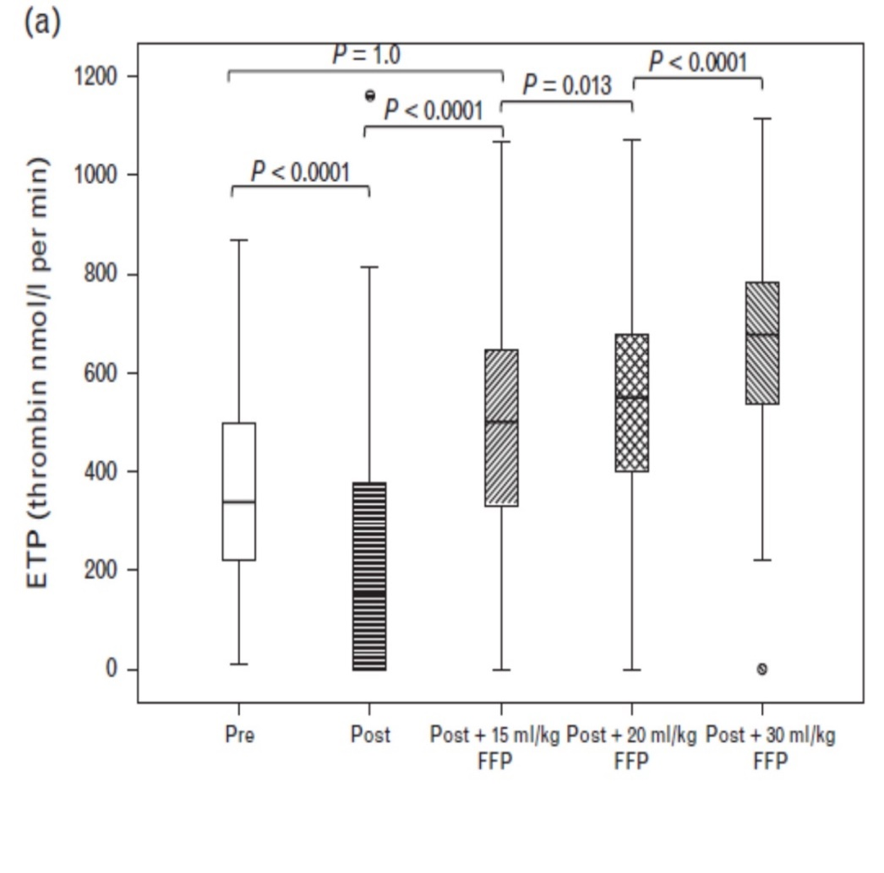
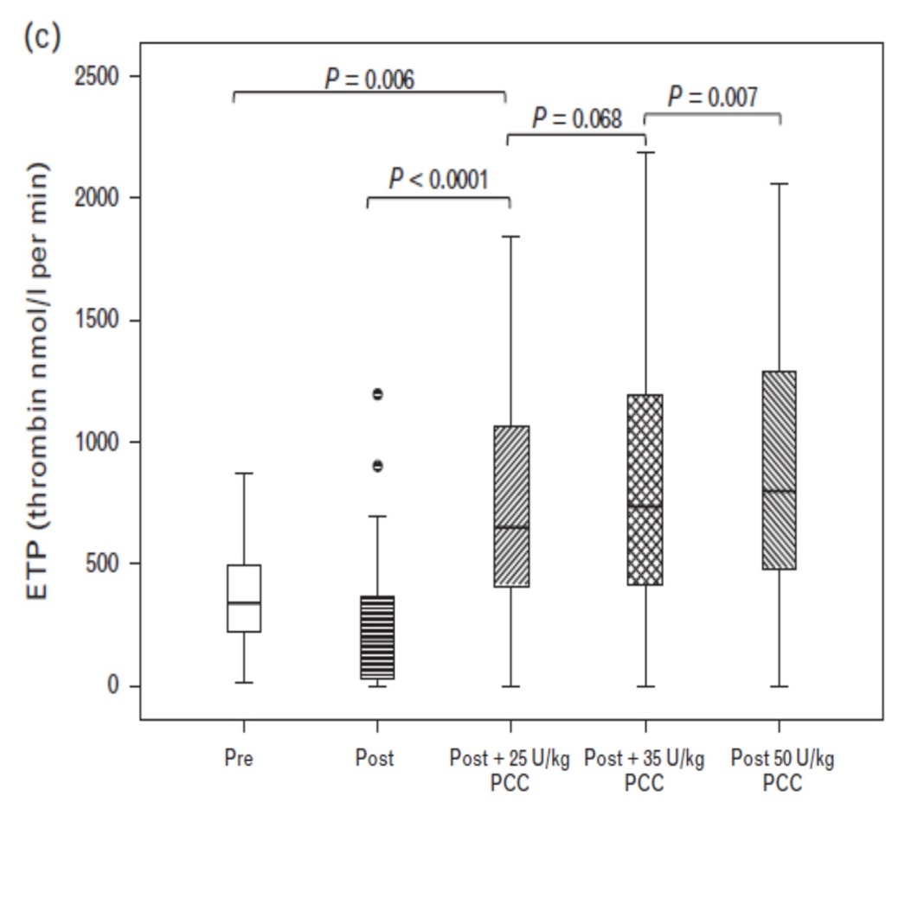
4F-PCC Versus FP for Thrombin Generation
1000
1000
Percy et al. Blood Coag Fibrinol 2015;26:357-367

Slide 7
Meta-analysis: Chest Tube Drainage
Viana et al. J Chest Surg 2024;57:25-35

Slide 8
Meta-analysis: RBC Transfusion
Viana et al. J Chest Surg 2024;57:25-35

Slide 9
Meta-analysis: Thromboembolic Events
Viana et al. J Chest Surg 2024;57:25-35

Slide 10
What does it all mean?
For management of bleeding due to coagulation factor deficiency during or after cardiac surgery
  Pilot RCT (and observational studies) suggest that PCC may be more effective without compromising safety
Existing data (on efficacy and safety) not conclusive
Adequately powered multicentre randomized trial warranted
  Feasibility of study procedures confirmed by pilot RCT
  Dose of 25 IU/kg recommended in cardiac surgery guidelines appears to be appropriate
Erdoes G, et al. A European consensus statement on the use of four-factor prothrombin complex concentrate for cardiac and non-cardiac surgical patients. Anaesthesia. 2021 Mar;76(3):381-392.

Slide 11
Karkouti K, Callum JL, Bartoszko J, et al; FARES-II Study Group
Prothrombin Complex Concentrate vs Frozen Plasma for Coagulopathic Bleeding in Cardiac Surgery
The FARES-II Multicenter Randomized Clinical Trial
Published online March 29, 2025
American College of Cardiology Annual Scientific Session (ACC.25)

Slide 12
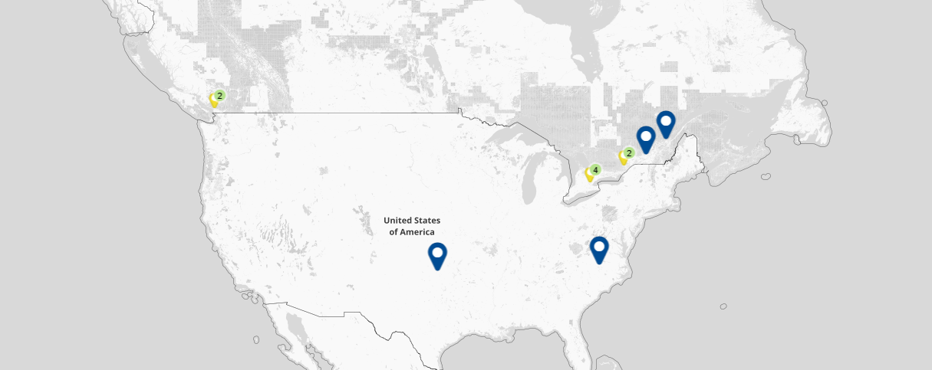


FARES-II study sites
University of Ottawa Heart Institute
PI: Diem Tran
Kingston Health Sciences Centre
PI: Tarit Saha
Canada
Royal Columbian Hospital
PI: Sukhpal Brar
2
Institut Universitaire de Cardiologie et de Pneumologie de Québec-Université Laval
PI: Etienne J. Couture
Vancouver General Hospital
PI: Darren Mullane
2
4
Montreal Heart Institute
PI: Antoine Rochon
The FARES-II (LEX-211) trial
was supported with funding from Octapharma AG (Lachen, Switzerland) and the Canadian Institutes of Health Research
United States
Sunnybrook Health Sciences Centre
PI: Yulia Lin
Toronto General Hospital
PI: Justyna Bartoszko
Hamilton General Hospital
PI: Michelle Zeller
University of Oklahoma Health Sciences Center
PI: Kenichi Tanaka
London Health Sciences Centre
PI: Christopher Harle
Duke University Health System
PI: Kamrouz Ghadimi

Slide 13
Background
In cardiac surgery, up to 15% of patients experience excessive bleeding, which is directly linked to increased morbidity and mortality.
Standard therapy for coagulopathic bleeding is frozen plasma (FP), occurring in up to 30% of patients.
Preliminary data suggest that a suitable alternative may be 4-factor prothrombin complex concentrate (PCC).
  PCCs have logistical advantages (ease, speed, volume of administration)
  PCCs are concentrated → Do they increase TEE risk?
  PCCs contain a subset of FP pro-coagulant factors → Are they as effective?

Slide 14
Objective
The objective of the FARES-II phase 3, non-inferiority, randomized controlled trial was to compare the efficacy and safety of PCC with FP in bleeding cardiac surgery patients.

Slide 15
Study design – FARES-II
Inclusion criteria:
12 sites:
10 Canada, 2 US
Intraoperative bleeding
Age ≥18 years undergoing cardiac surgery with CPB
Coagulation factor replacement with PCC or FP ordered in the OR for:
a) management of bleeding, or
b) anticipated bleeding
Known or suspected acquired coagulation factor deficiency
Final eligibility for initiating treatment post-CPB: At least moderate bleeding and INR ≥ 1.5
PCC or FP ordered
Exclusion criteria
Randomization
1st + 2nd orders
PCCª
1500 IU for BW ≤60 kg
2000 IU for BW >60 kg
FP
3 U for BW ≤60 kg
4 U for BW >60 kg
Including heart transplantation, insertion or removal of ventricular assist devices, repair of thoracoabdominal aneurysm, or TEE within 3 months prior to surgery
Subsequent orders
FP
Exclusion criteria:
Efficacy and Safety

Slide 16
Significant Study Procedures
Informed consent before surgery in USA sites and after surgery in Canadian sites
Randomized once PCC or FP ordered by clinicians
Treatment indication based on visual bleeding score and INR
  Moderate to severe bleeding
  INR ≥ 1.5 (POC)
Anticipated 20% of randomized patients to not receive treatment
Blinding maintained until treatment indications were met

Slide 17
Why INR to guide therapy?
The goal is to enhance thrombin generation
There are no good assays for measuring thrombin generation
  PT/INR: measures thrombin initiation
  CT: measures thrombin initiation
  CFT: measures dynamics of clot formation, a component of which is thrombin generation
They are surrogate measures of thrombin generation as they correlate to coagulation factor levels

Slide 18
Gulati et al. Arch Pathol Lab Med 2011;135:490-494

Slide 19
Primary endpoint
Hemostatic treatment response
‘Effective’ hemostatic treatment response
No additional hemostatic intervention (i.e., administration of any systemic
hemostatic therapies or interventions) was required from
60 minutes to 24 hours after the initiation of the first dose of IMP
‘Ineffective’ hemostatic treatment response
Additional hemostatic therapies or interventions administered
from 60 minutes to 24 hours after the initiation of the first dose of IMP
Or
Sample size: 410 patients provided ≥90% power to demonstrate non-inferiority
(margin 0.10; one-sided α 0.025; PCC 70% effective vs. FP 65% effective)

Slide 20
Selected other endpoints
Efficacy endpoints
Incidence of severe to massive bleeding | If received ≥5 RBC units or ≥5 non-IMP FP units, underwent surgical re-exploration due to bleeding, or received rFVIIa during the measured 24-hour time; or chest tube drainage >1 L at 12 hours after chest closure
Total number of ABPs (IMP and non-IMP) | Within 24 hours after CPB end
Total number of ABPs (non-IMP) | Within 24 hours after CPB end
Change in INR | Within 30 minutes before to 60 minutes after IMP initiation
Safety endpoints
Included the incidence of treatment-emergent AEs, treatment-emergent serious AEs, thromboembolic events, acute kidney injury, death, duration of mechanical ventilation, duration of intensive care unit stay, and duration of hospitalization; all measured up to postoperative day 30.

Slide 21
Results – patient disposition
538 patients enrolled
10 not randomized
5 no coagulation factor ordered
5 change in surgery complexity
and/or clinical judgment
528 patients randomized
Randomized to PCC
N=265
Randomized to FP
N=263
52 excluded post-randomization
27 consented, not treated
24 declined consent
16 treated, 8 not treated
1 unable to provide consent, not
treated
56 excluded post-randomization
33 consented, not treated
22 declined consent
13 treated, 9 not treated
1 unable to provide consent, treated
Treated with PCC and eligible for analysis
N=213
Treated with FP and eligible for analysis
N=207
4 excluded; protocol deviation
7 excluded; protocol deviation
PCC
PAS analysis: N=213
PP analysis: N=209
FP
PAS analysis: N=207
PP analysis: N=200

Slide 22
Patient baseline characteristics
Demographics and surgical characteristics were similar between the groups.
Demographics | PCC Group (N=213) | FP Group (N=207)
Age, median (IQR), years | 67 (58–73) | 64 (55–72)
Male/Female, No. (%) | 157/56 (74/26) | 152/55 (73/27)
Weight, mean (SD), kg | 85 (19) | 84 (20)
Myocardial infarction, No. (%) | 49 (23) | 48 (23)
Congestive heart failure, No. (%) | 36 (17) | 37 (18)
Stroke / TIA, No. (%) | 14 (7) | 15 (7)
Creatinine, median (IQR), mg/dL | 0.96 (0.8–1.1) | 0.95 (0.8–1.2)
Hemoglobin, median (IQR), g/dL | 13.7 (12.1–14.7) | 13.6 (11.9–14.6)
Platelets, median (IQR), x10³/µL | 201 (171–242) | 199 (163–244)
Surgical characteristics | PCC Group (N=213) | FP Group (N=207)
Previous cardiac surgery, No. (%) | 53 (25) | 56 (27)
Non-elective surgery, No. (%) | 36 (17) | 44 (21)
Complex surgery, No. (%) | 144 (68) | 152 (73)
Procedures, No. (%)
Aortic valve | 110 (52) | 98 (47)
Coronary artery bypass graft | 91 (43) | 86 (42)
Ascending aorta | 65 (31) | 61 (29)
Mitral valve | 48 (23) | 47 23)
Aortic arch | 26 (12) | 24 (12)
CPB duration, mean (SD), min | 171 (76.4) | 176 (80.5)
Circulatory arrest, No. (%) | 33 (15) | 34 (16)
Notes:
Complex surgery --- Procedures other than coronary artery bypass graft only, single valve only, or repair of atrial septal defect only.

Slide 23
Patient intervention details
High adherence to study protocol.
IMP characteristics | PCC Group (N=213) | FP Group (N=207)
Doses of IMP, No. (%)
1 | 213 (100) | 207 (100)
2 | 37 (17) | 47 (23)
Amount of IMP, Mean (SD)
1 | 23.9 (4.3) IU/kg | 11.8 (2.8) mL/kg
2 | 22.9 (6.3) IU/kg | 10.3 (3.8) mL/kg
Time from end of CPB to start of first dose of IMP, median (IQR), min | 41 (26–67) | 45 (28–69)
Time to complete IMP administration, median (IQR), min | 7 (4–10) | 26 (17–45)

Slide 24
Hemostatic response – primary endpoint
Hemostatic treatment response | PCC Group (N=213) | FP Group (N=207)
Effective, No. (%) | 166 (77.9) | 125 (60.4)
Ineffective, No. (%) | 47 (22.1) | 82 (39.6)
PCC to FP
Treatment difference (95% CI) | 17.55 (8.70, 26.40), P<0.001^{a,b}
Relative risk (95% CI) of hemostatic failure | 0.56 (0.41, 0.75), P<0.001^{a,b}
PCC was non-inferior and superior to FP for hemostatic effectiveness.^{a,b}
ªNon-inferiority tested using a one-sided Farrington-Manning score test with a non-inferiority margin of 10% at a significance level of 2.5%; ^{b}Superiority tested using a two-sided Farrington-Manning score test with a significance level of 5%.

Slide 25
Hemostatic response failure – a priori subgroups
Favors
PCC
Favors
FP
Group/Subgroup (PAS) | PCC Group, n/N (%) | FP Group, n/N (%) | Estimated difference, PCC – FP (95% CI), %
Primary analysis set | 47/213 (22.1) | 82/207 (39.6) | −17.55 (−26.40, −8.70)
Per-protocol analysis set | 45/209 (21.5) | 79/200 (39.5) | −17.97 (−26.91, −9.03)
Male | 38/157 (24.2) | 59/152 (38.8) | −14.61 (−24.98, −4.25)
Female | 9/56 (16.1) | 23/55 (41.8) | −25.75 (−42.76, −8.73)
Elective surgery | 40/177 (22.6) | 69/163 (42.3) | −19.73 (−29.67, −9.80)
Non-elective surgery | 7/36 (19.4) | 13/44 (29.5) | −10.10 (−29.58, 9.37)
Complex surgery | 35/144 (24.3) | 68/152 (44.7) | −20.43 (−31.31, −9.55)
Simple surgery | 12/69 (17.4) | 14/55 (25.5) | −8.06 (−22.47, 6.35)
CPB duration ≤120 minutes | 9/60 (15.0) | 14/48 (29.2) | −14.17 (−29.80, 1.47)
CPB duration 121–180 minutes | 12/72 (16.7) | 27/75 (36.0) | −19.33 (−33.81, −4.85)
CPB duration >180 minutes | 26/81 (32.1) | 41/84 (48.8) | −16.71 (−31.66, −1.76)
Age <65 years | 19/90 (21.1) | 45/104 (43.3) | −22.16 (−35.53, −8.79)
Age ≥65 years | 28/123 (22.8) | 37/103 (35.9) | −13.16 (−24.97, −1.35)
10% non-inferiority margin
Estimated difference in hemostatic response
failure rate, PCC – FP (95% CI), %

Slide 26
Selected other hemostatic efficacy endpoints
Efficacy endpoint (PAS) | PCC Group (N=213) | FP Group (N=207) | Difference (95% CI) | RR / LS mean ratio (95% CI) | P-value
Severe/massive bleeding, during 24 hours after CPB, No. (%) | 30 (14.1) | 57 (27.5) | 13.5 (5.8, 21.1) | RR: 0.51 (0.34, 0.76) | 0.001
Total ABPs (IMP and non-IMP) within 24 hours after CPB, LS mean (95% CI), units | 6.6 (5.9, 7.5) | 13.8 (12.3, 15.5) | 7.2 (5.4, 9.0) | Ratio: 0.48 (0.41, 0.57) | <0.001
Total ABPs (non-IMP) within 24 hours after CPB, LS mean (95% CI), units | 6.6 (5.7, 7.7) | 9.3 (8.0, 10.8) | 2.7 (1.0, 4.4) | Ratio: 0.71 (0.57, 0.88) | 0.002
Change in INR, LS mean (95% CI) | −0.84 (−0.77, −0.92) | −0.70 (−0.62, −0.77) | 0.15 (0.04, 0.26) | NA | 0.008

Slide 27
Safety (within 30 days after surgery start)
 | PCC Group (N=213) | FP Group (N=207)
Any AE, No. (%) [No. events] | 206 (96.7) [936] | 201 (97.1%) [976]
Any serious AE, No. (%) [No. events] | 77 (36.2) [138] | 98 (47.3) [201]
Thromboembolic AEs, No. (%) [No. events] | 18 (8.5) [26] | 15 (7.2) [18]
Stroke | 5 (2.3) [5] | 5 (2.4) [5]
Vascular thrombosis | 15 (7.0) [16] | 11 (5.3) [11]
Other | 5 (2.3) [5] | 2 (1.0) [2]
Death, No. (%) | 7 (3.3) | 8 (3.9)
Acute kidney injury, No. (%) | 22 (10.3) | 39 (18.8)
Duration of mechanical ventilation, median (IQR), days | 1.0 (1.0–2.0) | 1.0 (1.0–2.0)
Duration of initial ICU stay, median (IQR), days | 4.0 (2.0–6.0) | 4.0 (2.0–7.0)
Duration of initial hospitalization, median (IQR), days | 8.0 (7.0–12.0) | 9.0 (7.0–13.0)

Slide 28
Safety (within 30 days after surgery start)
 | PCC Group (N=213) | FP Group (N=207)
Any serious AE, No. (%) | 77 (36.2) | 98 (47.3)
Relative risk (95% CI), PCC to FP | 0.76 (0.61, 0.96), P=0.02
Acute kidney injury, No. (%) | 22 (10.3) | 39 (18.8)
Relative risk (95% CI), PCC to FP | 0.55 (0.34, 0.89), P=0.02

Slide 29
Conclusions
PCC is non-inferior and superior to FP for hemostatic response in the management of excessive bleeding related to coagulation factor deficiency in patients undergoing cardiac surgery.
The greater hemostatic efficacy of PCC over FP was shown across multiple endpoints and was not accompanied by an increase in thromboembolic events.
PCC may have safety advantages over FP, as shown by the significantly reduced risk of serious adverse events and acute kidney injury.
These potentially practice-changing results support the use of PCC over FP for bleeding management in cardiac surgery.

Slide 30
Thank you

