Slide 1

Summary of Traumatic Brain Injury (TBI) Literature
Breakthroughs in blood webinar October 25, 2024
HEMOTION Resource:
Slide deck

Slide 2
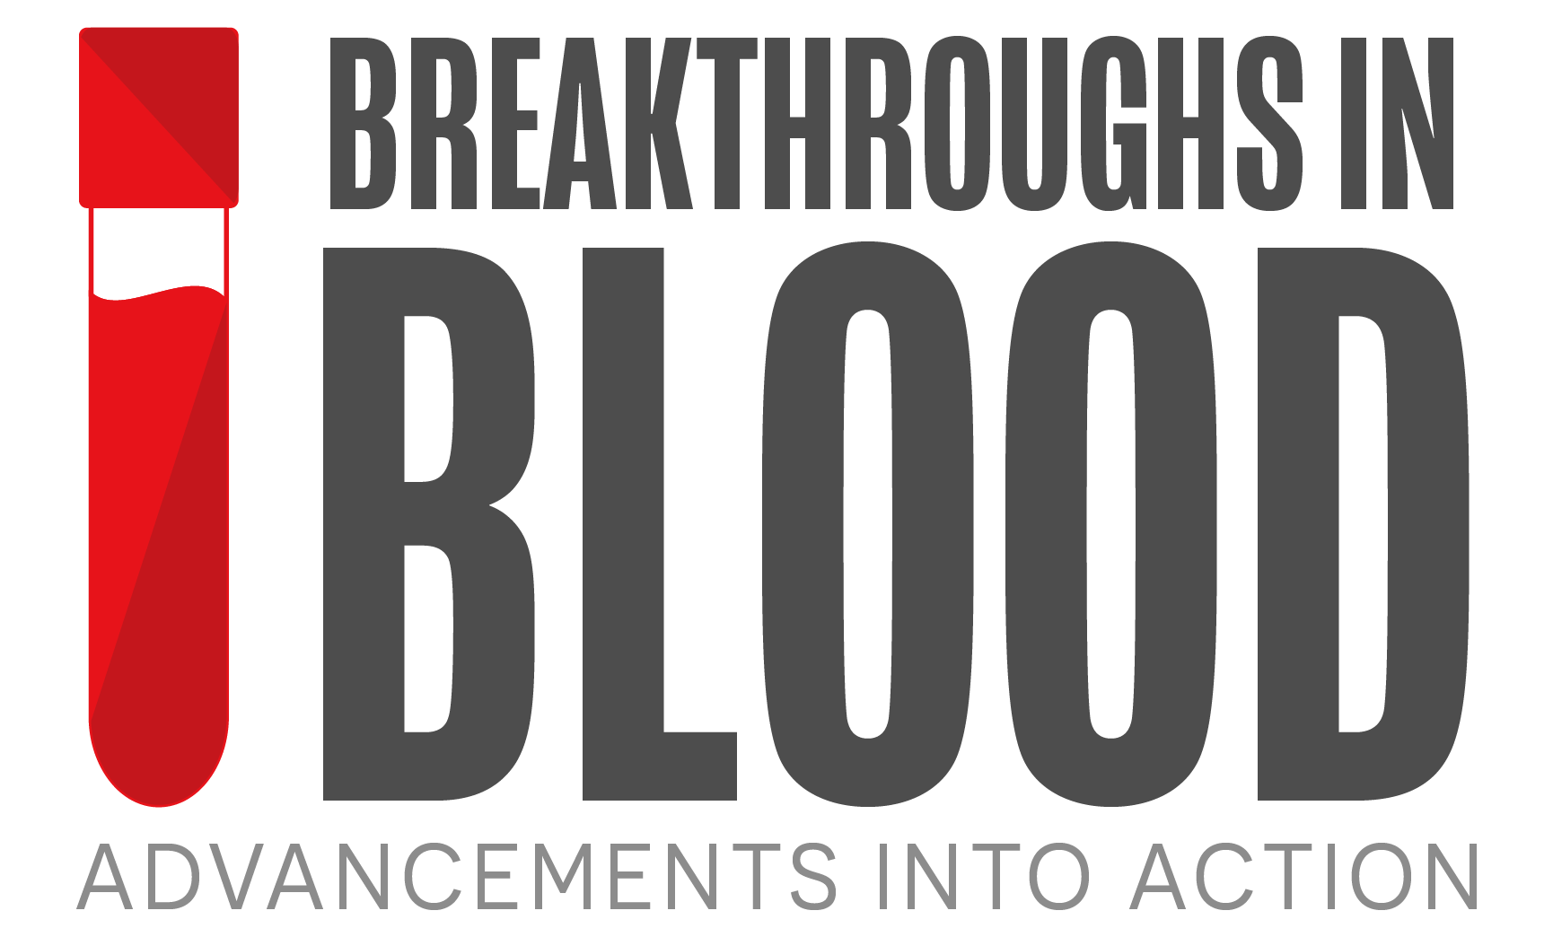
Purpose
This resource was created in January 2025 for the Breakthroughs in blood: Advancements into action webinar series and is available on Canadian Blood Services’ professional education website, Profedu.ca.
It is intended for educational or informational purposes only.

Slide 3
Acknowledgements
We would like to thank the following individuals for their contributions to this resource:
Jeannie Callum, MD, FRCPC / Transfusion medicine – Kingston, Canada
Alexis Turgeon, MD, MSc, FRCPC / Critical Care Medicine – Québec City, Canada
Rosemary Kozar, MD, PhD / General Surgery – Baltimore, USA
Gregory Hawryluk, MD, PhD, FRCPC / Neurosurgery – Cleveland, USA
Victoria McCredie, PhD, UCNS, FRCPC / Critical Care Medicine – Toronto, Canada

Slide 4




A multicenter, randomized, controlled clinical trial
Of transfusion requirements in critical care (TRICC)
Hébert PC et al. The New England Journal of Medicine. Published February 11, 1999. doi: 10.1056/NEJM199902113400601
Do restrictive strategies for RBC transfusion and liberal strategies produce equivalent results in critically ill patients?
A restrictive strategy of RBC transfusion is at least as effective as and possibly superior to a liberal transfusion strategy in some critically ill patients.
Scan or click to view
the article

Slide 5




TRICC Study
Population
Intervention
Findings
Mortality rate at 30 days
524 Men
838 Patients analyzed
Liberal transfusion
Restrictive transfusion
314 Women
98 of 420 patients
78 of 418 patients
Patients in intensive care with low hemoglobin (≤ 9g/dL)
420
418
Liberal transfusion
Restrictive transfusion
Stratified by center and disease severity
APACHE II score
23.3%
18.7%
RBC transfusion
triggered by hemoglobin level < 10g/dL
RBC transfusion
triggered by hemoglobin level < 7g/dL
Difference was not statistically significant:
Location
Primary outcome
Absolute difference, 4.7%
Death from all causes in the 30 days after randomization.
(95% CI, -0.84% to 10.2%; p = .11)
25 ICUs
in Canada
Scan or click to view
the article

Slide 6
Liberal or Restrictive Transfusion Strategy in Patients with Traumatic Brain Injury (HEMOTION study)
Turgeon AF et al. The New England Journal of Medicine.
Published online June 13, 2024. doi: 10.1056/NEJMoa2404360
Does a liberal strategy for RBC transfusion lead to better long-term functional outcomes compared to a restrictive strategy in critically ill
adults with traumatic brain injury and anemia?
The risk of an unfavourable neurologic outcome at 6 months was similar between a liberal vs restrictive transfusion for critically ill patients with acute moderate or severe traumatic brain injury and anemia
Scan or click to view
the article

Slide 7
HEMOTION Study
Population
Intervention
Findings
Unfavourable neurological outcome at 6 months
542 Men
742 Patients randomized
736 Patients analyzed
Liberal transfusion
Restrictive transfusion
200 Women
249 of 364 patients
263 of 358 patients
Patients in intensive care with low hemoglobin (≤ 10 g/dL)
369
367
Liberal transfusion
Restrictive transfusion
Acute moderate or severe traumatic brain injury
RBC transfusion
triggered by hemoglobin level ≤ 10 g/dL
RBC transfusion
triggered by hemoglobin level ≤ 7 g/dL
68.4%
73.5%
Mean age: 48.7 years
Location
Primary outcome
Risk reduction was not statistically significant:
34 centres in
Canada
United Kingdom
France
Brazil
Outcome: unfavorable neurological outcome
Adjusted risk reduction, 5.4% (95% CI, -2.9 to 13.7)
Glasgow Outcome Scale Extended score using a sliding dichotomy approach,
six months after randomization
Scan or click to view
the article

Slide 8
Restrictive vs liberal transfusion strategy in patients with acute brain injury the TRAIN randomized clinical trial
Taccone FS et al. JAMA. Published online October 09, 2024. doi:10.1001/jama.2024.20424
How does use of a liberal or restrictive strategy of blood transfusion influence neurological outcome among patients with acute brain injury?
A liberal transfusion strategy compared with a restrictive strategy resulted in a lower rate of unfavorable neurological outcome among patients with acute brain injury and anemia.
Scan or click to view
the article

Slide 9
TRAIN Study
Population
Intervention
Findings
Unfavourable neurological outcome at 180 days
444 Men
850 Patients randomized
806 Patients analyzed
Liberal transfusion
Restrictive transfusion
376 Women
246 of 393 patients
300 of 413 patients
Patients in intensive care with low hemoglobin (< 9g/dL)
393
413
Liberal transfusion
Restrictive transfusion
Traumatic brain injury
Subarachnoid hemorrhage
Intracerebral hemorrhage
RBC transfusion
triggered by hemoglobin level < 9g/dL
RBC transfusion
triggered by hemoglobin level < 7g/dL
62.6%
72.6%
Mean age: 51 years
Difference was statistically significant:
Location
Primary outcome
Absolute difference, -10.0% (95% CI, -16% to -3.6%)
72 ICUs in 22 countries
Outcome: unfavourable neurological outcome
Adjusted relative risk, 0.86 (95% CI, 0.79 to 0.94; p = .002)
Glasgow Outcome Scale Extended score between 1 and 5, 180 days after randomization
Scan or click to view
the article

