Slide 1
Octaplasma (Solvent Detergent [S/D] Plasma): Clinical overview
January 2023
This document may be found on: Canadian Blood Services’ professional education website, profedu.ca​
Information is current to January 12, 2023. Always refer to the Product Monograph for up-to-date information. Our product portfolio (octapharma.ca)​
Notes:
Solvent detergent (S/D) plasma: clinical overview

Slide 2

Overview
Pathogen-reduced inventory at Canadian Blood Services
  Benefits of pathogen inactivation
Octapharma S/D process
Octaplasma product characteristics
Safety:
  Infectious complications
  Other considerations
Indications and contraindications
Selected special populations
Additional resources
This document may be found on: Canadian Blood Services’ professional education website, profedu.ca​
Information is current to January 12, 2023. Always refer to the Product Monograph for up-to-date information. Our product portfolio (octapharma.ca)​
Notes:
This presentation will cover the following topics:
Pathogen-reduced inventory at Canadian Blood Services including the benefits of pathogen inactivation
The Octapharma S/D process;
Octaplasma product characteristics;
Safety, including infectious complications and other considerations;
Indications and contraindications;
Selected special populations; and
Additional resources

Slide 3
Acronyms used
Acronym | Name | Acronym | Name
S/D | Solvent detergent | HAV | Hepatitis A virus
FP | Frozen plasma | HEV | Hepatitis E virus
FFP | Fresh frozen plasma | TRALI | Transfusion-related acute lung injury
NAT | Nucleic acid testing | vCJD | Variant Creutzfeld-Jakob disease
HIV | Human immunodeficiency virus | HLA | Human leukocyte antigen
HBV | Hepatitis B virus | HNA | Human neutrophil antigen
HCV | Hepatitis C virus | HBsAg | Hepatitis B surface antigen
DIC | Disseminated intravascular coagulation | aPTT | Activated prothrombin time
TNBP | Tri(nbutyl)- phosphate | INR | International normalized ratio
This document may be found on: Canadian Blood Services’ professional education website, profedu.ca​
Information is current to January 12, 2023. Always refer to the Product Monograph for up-to-date information. Our product portfolio (octapharma.ca)​
Notes:
These acronyms will be used during the presentation.

Slide 4

A pathogen-reduced inventory at Canadian Blood Services
This document may be found on: Canadian Blood Services’ professional education website, profedu.ca​
Information is current to January 12, 2023. Always refer to the Product Monograph for up-to-date information. Our product portfolio (octapharma.ca)​
Notes:
Read slide

Slide 5
Benefits of pathogen inactivation
Reduces the residual risk of transfusion-transmitted infections, providing an additional layer of safety and complementing donor selection criteria and donation testing.
Reduces the risk of emerging or unknown pathogens that can be transmitted during transfusion to a patient.
Removal of white blood cells reduces the risk of transfusion-associated graft versus host disease, a rare and usually fatal adverse reaction.
This document may be found on: Canadian Blood Services’ professional education website, profedu.ca​
Information is current to January 12, 2023. Always refer to the Product Monograph for up-to-date information. Our product portfolio (octapharma.ca)​
Notes:
There are many benefits of pathogen inactivation. It reduces the residual risk of transfusion transmitted infections that remain after donor screening and donation testing. It reduces the risk of emerging or unknown pathogens that can be transmitted during transfusion to a patient. And finally, it reduces the risk of a fatal adverse transfusion reaction, transfusion associated graft-vs-host disease, by rendering white cells inactive.
All of these contribute to improved patient safety.

Slide 6
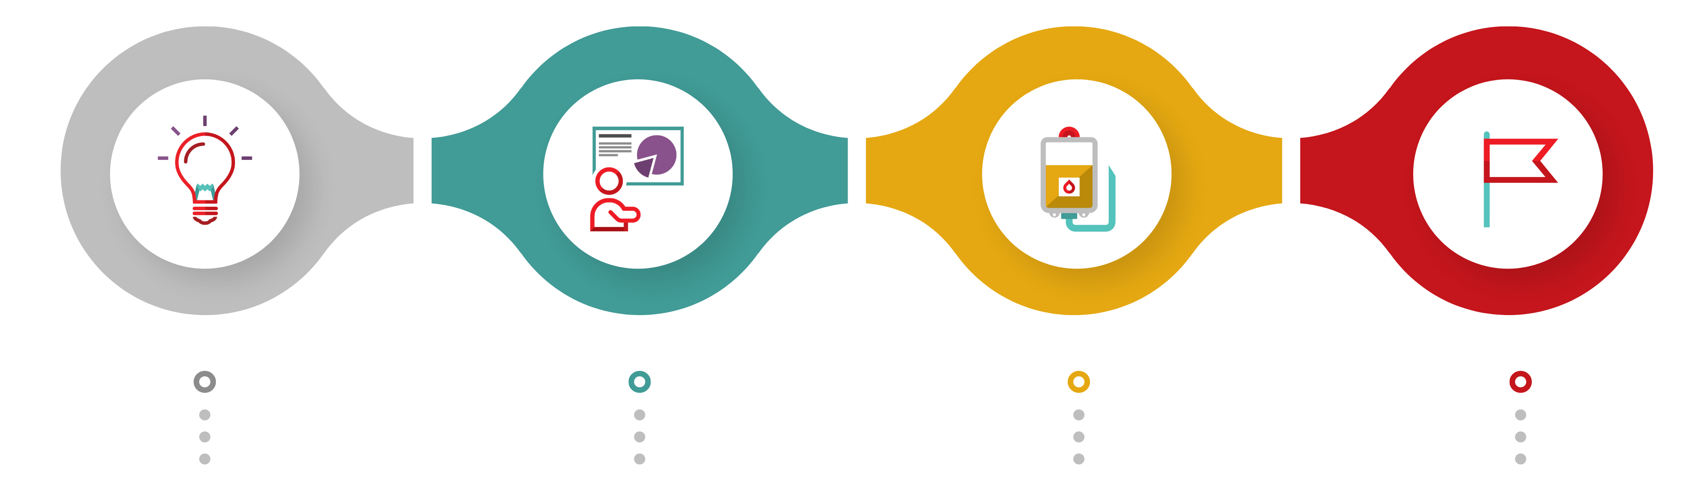
Our journey toward pathogen-reduced plasma
2007
2023
2024
2025
Hosted international consensus conference on pathogen inactivation technologies.
Transition to Octaplasma (S/D plasma) to begin in March. Goal of >80% of plasma use consisting of Octaplasma by September 2023.
Introduction of pathogen-reduced plasma manufactured by Canadian Blood Services tentatively planned late 2024/2025.
Goal for majority of platelets and plasma for transfusion to be pathogen-reduced.
This document may be found on: Canadian Blood Services’ professional education website, profedu.ca​
Information is current to January 12, 2023. Always refer to the Product Monograph for up-to-date information. Our product portfolio (octapharma.ca)​
Notes:
As an additional layer of patient safety, Canadian Blood Services aims to introduce pathogen-reduced components and products, wherever possible. In 2007, we hosted an international consensus conference on pathogen inactivation technologies **including solvent detergent treatment for plasma** which at that time were starting to be used in some European countries.
Transition to S/D plasma as the main product for transfusion will begin in March 2023. The goal is that at least 80% of plasma use will consist of S/D plasma by September 2023.
The introduction of Canadian Blood Services collected pathogen-reduced plasma, to be made available alongside S/D plasma, is tentatively planned for late 2024/25.
Once implemented, it is expected that approximately 80% of plasma use will consist of S/D plasma and 20% will consist of Canadian Blood Services collected pathogen-reduced plasma.
By 2025, the goal is for the majority of platelets and plasma for transfusion to be pathogen-reduced.

Slide 7



Solvent detergent treatment of plasma
S/D treatment reduces the risk of transfusion-transmitted pathogen infections and provides an additional layer of safety against:
      Enveloped viruses (including hepatitis B and C and HIV)
      Bacteria (gram-positive, gram-negative, spirochete)
      Protozoa parasites
      Prions
      White blood cells (leukocytes)
Only effective for viruses enveloped in a lipid coat and/or large enough to be filtered. Not effective against hepatitis A virus and parvovirus B19.
This document may be found on: Canadian Blood Services’ professional education website, profedu.ca​
Information is current to January 12, 2023. Always refer to the Product Monograph for up-to-date information. Our product portfolio (octapharma.ca)​
Notes:
Plasma is produced from whole blood collections and from apheresis collections. Solvent detergent treatment reduces the risk of transfusion-transmitted pathogen infections and provides an additional layer of safety against:
Enveloped viruses (including Hepatitis B and C and HIV);
Bacteria;
Protozoa parasites;
Prions; and
White blood cells
However, please note that solvent detergent treatment is only effective for viruses enveloped in a lipid coat and/or large enough to be filtered. It is not effective against hepatitis A virus and parvovirus B19, so there are other risk-reducing steps in place for these viruses.

Slide 8
Why Octaplasma?
Octaplasma is a pathogen-reduced form of frozen plasma that reduces the risk of transfusion-transmitted viral infections and other adverse reactions.
Until March 2023, Octaplasma, the S/D plasma manufactured by Octapharma, was only available for special patient populations.
The most timely and cost-effective path to a pathogen-reduced plasma supply is through the expanded purchasing of Octaplasma.
This document may be found on: Canadian Blood Services’ professional education website, profedu.ca​
Information is current to January 12, 2023. Always refer to the Product Monograph for up-to-date information. Our product portfolio (octapharma.ca)​
Notes:
In Canada, Octaplasma is the commercial name for the S/D plasma manufactured by Octapharma. Octaplasma is a pathogen-reduced form of frozen plasma that reduces the risk of transfusion-related viral infections and other adverse reactions.
Until March 2023, Octaplasma, the S/D plasma manufactured by Octapharma, was only available for special patient populations. Making it available to all patients is the most timely and cost-effective path to a pathogen-reduced plasma supply.

Slide 9
Benefits of Octaplasma
For patients
Enhanced safety profile: decreased risk of bacterial, viral, protozoal infection
May be associated with decreased incidence of adverse transfusion reactions: allergic, transfusion related acute lung injury (TRALI), other immune reactions
Consistent levels of coagulation factors
For the blood system
Increased plasma available for fractionation
This document may be found on: Canadian Blood Services’ professional education website, profedu.ca​
Information is current to January 12, 2023. Always refer to the Product Monograph for up-to-date information. Our product portfolio (octapharma.ca)​
Notes:
Using Octaplasma provides the following benefits to patients:
Decreased risk of bacterial, viral, protozoal infection;
It may be associated with a decreased risk of adverse reactions including allergic reactions, transfusion related acute lung injury (TRALI), and other immune reactions; and
The units have consistent levels of coagulation factors
The use of Octaplasma also benefits the blood system as it results in increased Canadian plasma available for fractionation.

Slide 10

Octapharma
S/D process
This document may be found on: Canadian Blood Services’ professional education website, profedu.ca​
Information is current to January 12, 2023. Always refer to the Product Monograph for up-to-date information. Our product portfolio (octapharma.ca)​
Notes:
The next few slides will review Octapharma’s manufacturing process for solvent detergent treated plasma.

Slide 11
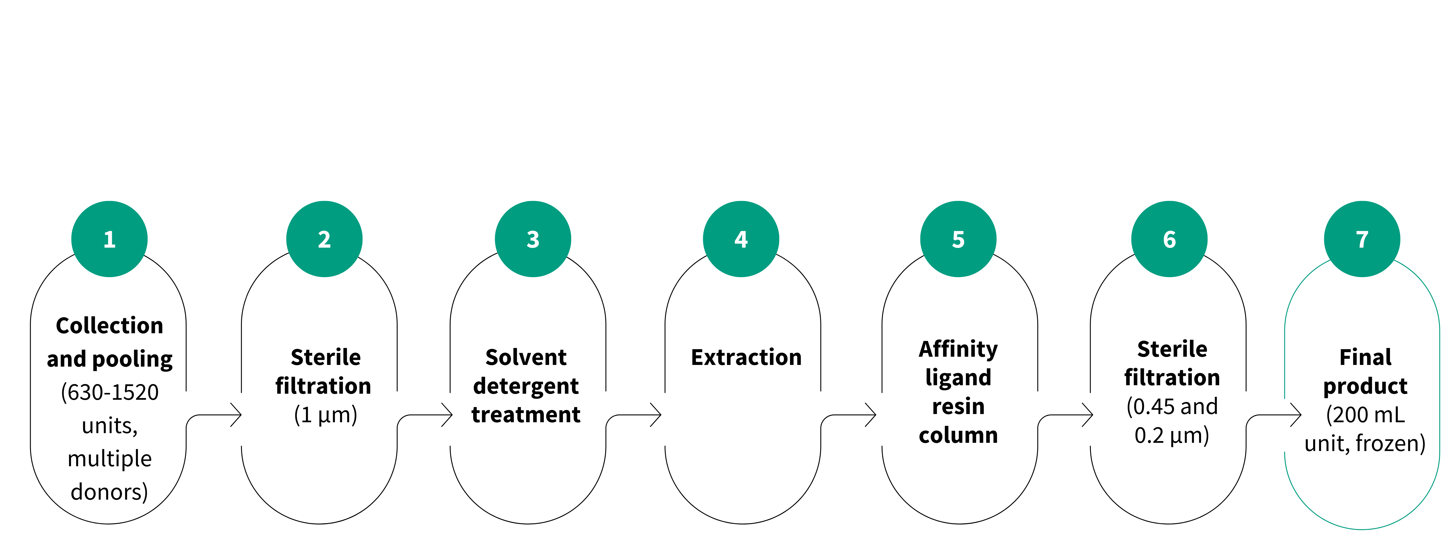
Octaplasma manufacturing
Reduces neutralizing antibodies through dilution
Lowers antibody titres against blood cells and plasma proteins.
Removes white blood cells and potentially other contaminants.
1 % TNBP (solvent) speeds aggregation between lipid coat and detergent.
1 % octoxynol (detergent) interrupts interactions between molecules in virus' lipid coating.
Castor oil extraction removes TNBP.
Solid phase extraction removes octoxynol.
Removes prions, including the infectious agent causing vCJD.
Removes leukocytes, parasites and larger non-enveloped viruses.
Aseptically packaged in blood bags, over-wrapped and frozen.
Information provided by Octapharma (Nov 15, 2022) and Octaplasma Product Monograph.
This document may be found on: Canadian Blood Services’ professional education website, profedu.ca​
Information is current to January 12, 2023. Always refer to the Product Monograph for up-to-date information. Our product portfolio (octapharma.ca)​
Notes:
Pooled plasma from 630-1520 donors is treated pooled. This step reduces neutralizing antibodies that may be present in the plasma pool through dilution and lowers the antibody titres against blood cells and plasma proteins.
The pooled plasma then undergoes sterile filtration steps resulting in complete leukocyte removal without activating the leukocytes as well as the removal of removal of prions, parasites and viruses.
The pooled plasma is treated with a combination of 1 % Tri(nbutyl)-phosphate, or TNBP, and 1 % octoxynol. The TNBP is the solvent and the octoxynol is the detergent.
The solvent creates an environment in which the aggregation reaction between the lipid coat and the detergent happen more rapidly. The detergent interrupts the interactions between the molecules in the virus' lipid coating. Most enveloped viruses cannot exist without their lipid coating so are destroyed (or unable to reproduce) when exposed to these detergents.
The solvent and detergent reagents are removed by castor oil extraction, which removes TNBP, and solid phase extraction which removes the Octoxynol.
The plasma is run through an affinity ligand resin column which specifically remove prion proteins. This safety measure is considered effective for removing the infectious agent causing vCJD, if present in plasma.
The final product is aseptically packaged into pyrogen-free, plasticized polyvinyl chloride blood bag, overwrapped with a polyamide/polyethylene film and frozen.

Slide 12

Octaplasma characteristics
This document may be found on: Canadian Blood Services’ professional education website, profedu.ca​
Information is current to January 12, 2023. Always refer to the Product Monograph for up-to-date information. Our product portfolio (octapharma.ca)​
Notes:
Let’s look at the product characteristics of Octaplasma.

Slide 13
Clotting factor activity
Octaplasma has similar pharmacokinetic properties as FP
The coagulation activity values are close to the corresponding values for normal human single-donor FP and a minimum of 0.5 IU/mL is obtained for all clotting factors.
More consistent and standardized clotting factor content compared with single donor plasma (levels in single donor plasma may have a wide reference range [50–200%]).
  Levels of protein S, alpha-2 antiplasmin are reduced.
This document may be found on: Canadian Blood Services’ professional education website, profedu.ca​
Information is current to January 12, 2023. Always refer to the Product Monograph for up-to-date information. Our product portfolio (octapharma.ca)​
Notes:
Solvent detergent treated plasma has similar pharmacokinetic properties as frozen plasma.
The coagulation activity values are close to the corresponding values for normal human single-donor FP and a minimum of 0.5 IU/mL is obtained for all clotting factors.
The levels of coagulation factors and proteins are more consistent than FP as levels of clotting factors and inhibitors in single plasma units have a wide reference range from 50 to 200%.
As a result of the S/D treatment and purification, the levels of protein S and alpha-2 antiplasmin are reduced.

Slide 14
Plasma protein levels
Parameters | Octaplasma (n=12) Mean (min–max) | Reference ranges FFP
Total protein (mg/mL) | 55 (54–57) | 48–64
Albumin (mg/mL) | 32 (30–34) | 28–41
Fibrinogen (mg/mL) | 2.5 (2.4–2.6) | 1.45–3.85
IgG (mg/mL) | 9.65 (9.15–10.10) | 6.60–14.50
IgA (mg/mL) | 2.00 (1.80–2.05) | 0.75–4.20
IgM (mg/mL) | 1.25 (1.20–1.30) | 0.40–3.10
Factor V (IU/mL) | 0.78 (0.75–0.84) | 0.54–1.45
Factor VII (IU/mL) | 1.08 (0.90–1.17) | 0.62–1.65
Factor X (IU/mL) | 0.78 (0.75–0.80) | 0.68–1.48
Factor XI (IU/mL) | 0.99 (0.91–1.04) | 0.42–1.44
Protein C (IU/mL) | 0.85 (0.81–0.87) | 0.58–1.64
Protein S (IU/mL) | 0.64 (0.55–0.71) | 0.56–1.68
Plasmin inhibitor (IU/mL) | 0.23 (0.20–0.27) | 0.72–1.32
Coagulation factor levels above 0.5 IU/mL
Modest reduction of protein S, more significant reduction in alpha-2 antiplasmin
12 consecutive batches Octaplasma were investigated; mean (minimum–maximum) values are presented; FFP, single-donor fresh-frozen plasma
Information from Octaplasma Product Monograph.
This document may be found on: Canadian Blood Services’ professional education website, profedu.ca​
Information is current to January 12, 2023. Always refer to the Product Monograph for up-to-date information. Our product portfolio (octapharma.ca)​
Notes:
This slide is for your reference and is from the Octaplasma Product Monograph. It provides a comparison of specific protein, immune globulin and factor levels in Octaplasma and plasma. Note that the study being referenced used fresh frozen plasma as opposed to frozen plasma, which is the product available from CBS; however, results would be expected to be similar.
The coagulation factor levels are above 0.5 international units per millilitre. Also note that there is a modest reduction of protein S levels and a more significant reduction of alpha-2 antiplasmin levels.

Slide 15
Dosage (from Product Monograph)
From the Octaplasma product monograph:
The dosage depends upon the clinical situation and underlying disorder
12–15 mL/kg body weight is a generally accepted starting dose.
  This dose should increase the patient's plasma coagulation factor levels by approximately 25%.
Sample Octaplasma dose calculation
Dose for a patient weighing 70 kg, where one unit of S/D plasma has a volume of 200 mL.
70 kg x (12–15 mL/kg) = 840 – 1,050 mL = 4–5 units
As with all plasma transfusions, it is important to monitor the response, both clinically and with measurement of coagulation tests (i.e., INR, aPTT, and/or specific coagulation factor assays).
This document may be found on: Canadian Blood Services’ professional education website, profedu.ca​
Information is current to January 12, 2023. Always refer to the Product Monograph for up-to-date information. Our product portfolio (octapharma.ca)​
Notes:
The required dosage of Octaplasma depends upon the clinical situation and underlying disorder.
Similar to frozen plasma, 12-15 mL of plasma per kg body weight is a generally accepted starting dose and would be expected to increase the patient's plasma coagulation factor levels by approximately 25%.
As an example, for a patient who weighs 70 kg, the appropriate dose would be 4-5 units of plasma.
As with all plasma transfusions, it is important to monitor the response, both clinically and with measurement of appropriate coagulation tests.

Slide 16

Clinical considerations (from Product Monograph)
Clinical efficacy
Similar to FP
Dose
Dosing volume is similar to that for FP (12–15 mL/kg)
Dosing by number of units may be different
Selection of patients
Acceptable for almost all patient groups
Severe protein S deficiency is very rare (may present with thrombosis)
If a patient has a contraindication to the use of Octaplasma, FP remains available
MORE units may be required as unit volume is smaller (but consistent)
200 mL (Octaplasma) vs.
270-300 mL (untreated plasma)
This document may be found on: Canadian Blood Services’ professional education website, profedu.ca​
Information is current to January 12, 2023. Always refer to the Product Monograph for up-to-date information. Our product portfolio (octapharma.ca)​
Notes:
Solvent detergent plasma can be considered similar to frozen plasma with the same clinical efficacy.
As noted previously, the dosing volume is the same as for frozen plasma, but it is very important to note that, when dosing by number of units, more units may be required as the unit volume is smaller with Octaplasma units being 200 mL and plasma units generally ranging from 270 to 300 mL.
Medical judgement is required, but, in general, solvent detergent plasma is acceptable for almost all patient groups.
It should not be used in patients with severe protein S deficiency, which is a rare condition that may present with thrombosis. If a patient has a contraindication to the use of S/D plasma, FP remains available.

Slide 17
Administration (from Product Monograph)
Must be ABO-blood group compatible
High dosages or infusion rates may induce hypervolemia, pulmonary edema and/or cardiac failure.
High infusion rates may cause adverse effects as a result of citrate toxicity (fall in ionized calcium), especially in patients with liver function disorders.
  Risk of citrate toxicity
  Due to this risk, the infusion rate should not exceed:
  0.020–0.025 mmol citrate/kg body weight/minute = 1 mL/kg body weight/minute
Effects of citrate can be minimized by giving calcium gluconate IV (using another line)
This document may be found on: Canadian Blood Services’ professional education website, profedu.ca​
Information is current to January 12, 2023. Always refer to the Product Monograph for up-to-date information. Our product portfolio (octapharma.ca)​
Notes:
The administration of Octaplasma must be ABO-blood group compatible.
Like regular plasma, high dosages or infusion rates may induce hypervolemia, pulmonary edema and/or cardiac failure. High infusion rates may also cause cardiovascular effects as a result of citrate toxicity which can cause a fall in ionized calcium, especially in patients with liver function disorders. The effects of citrate can be minimized by giving calcium gluconate IV using another line to administer.

Slide 18

Safety: infectious complications
This document may be found on: Canadian Blood Services’ professional education website, profedu.ca​
Information is current to January 12, 2023. Always refer to the Product Monograph for up-to-date information. Our product portfolio (octapharma.ca)​
Notes:
How safe is Octaplasma, when considering infectious risks?

Slide 19
Testing of donors and plasma pools
Controls are applied to the selection and screening of donors for hepatitis B (HBV), hepatitis C (HCV) and human immunodeficiency virus (HIV) infection.
The plasma pools are also tested for:
  Hepatitis B surface antigen (HBsAg )
  Anti-HIV 1/2 antibodies
  Nucleic acid testing (NAT) for: HIV, HAV, HBV, HCV, HEV and parvovirus B19
This document may be found on: Canadian Blood Services’ professional education website, profedu.ca​
Information is current to January 12, 2023. Always refer to the Product Monograph for up-to-date information. Our product portfolio (octapharma.ca)​
Notes:
Controls are applied to the selection and screening of donors for hepatitis B, hepatitis C and HIV infection.
The plasma pools are also tested for:
Hepatitis B surface antigen;
Antibodies against HIV types 1 and 2;
And nucleic acid testing for HIV, hepatitis A, hepatitis B, hepatitis C, hepatitis E and parvovirus B19

Slide 20
HAV and parvovirus B19
S/D treatment is not effective against HAV and parvovirus B19, and pooling increases donor exposure.
Risk is decreased by:
Testing of donors for HAV and B19
Dilution of the plasma
Presence of neutralizing antibodies towards HAV and parvovirus B19 in the starting plasma and final product
Neutralizing antibodies result in immune neutralization and passive immunization
Both serve to limit or prevent virus replication in vivo and may limit risk of infection, although no laboratory or clinical studies have been performed to show this is sufficient ​at preventing infection.
This document may be found on: Canadian Blood Services’ professional education website, profedu.ca​
Information is current to January 12, 2023. Always refer to the Product Monograph for up-to-date information. Our product portfolio (octapharma.ca)​
Notes:
The solvent detergent method has no effect on non-enveloped viruses such as HAV and parvovirus B19.
Because plasma is pooled, it is associated with increased donor exposure which means that there is an increased risk of transmitting these viruses.
This risk is decreased by:
Testing of donors for hepatitis A and parvovirus B19
Dilution of the plasma; AND
The presence of required limits for neutralizing antibodies towards hepatitis A and parvovirus B19 in the starting plasma and the final product. This results in immune neutralization and passive immunization for these viruses which serves to limit or prevent virus replication in the body and may limit the risk of infection, although no laboratory or clinical studies have been performed to show that it is sufficient to prevent infection.

Slide 21

Safety: other considerations
This document may be found on: Canadian Blood Services’ professional education website, profedu.ca​
Information is current to January 12, 2023. Always refer to the Product Monograph for up-to-date information. Our product portfolio (octapharma.ca)​
Notes:
Next, we will consider other non-infectious considerations.

Slide 22
Allergic reactions
The literature suggests that the large plasma pools may reduce adverse transfusion reactions (ATR) caused by a high allergen dose from a single donor.
Hemovigilance data from several European countries report a lower rate of ATR with S/D treated plasma transfusion.^{1,2}
Study of patients with thrombotic thrombocytopenic purpura (TTP) receiving plasma exchange with history of moderate to severe reaction: Overall ATR rate per procedure decreased from 35.0% (95% CI = 15.4%-59.2%) with untreated plasma to 1.4% ([1/73] 95% CI = 0.0%-7.4%) with S/D treated plasma.³
References (see slide 37):
Saadah NH et al. Haematologica 2020.
Liumbruno GM, Franchini M. J Thromb Thrombolysis 2015.
McGonigle AM et al. Transfusion 2020.
This document may be found on: Canadian Blood Services’ professional education website, profedu.ca​
Information is current to January 12, 2023. Always refer to the Product Monograph for up-to-date information. Our product portfolio (octapharma.ca)​
Notes:
Solvent detergent treated plasma is prepared from a pool of 630-1520 single-donor plasma units. Pooling of plasma from many donors might theoretically reduce adverse transfusion reactions caused by a high dose of allergen from a single donor and this is suggested by the available literature.
This is supported by hemovigilance data from several European countries reporting a lower rate of adverse transfusion reactions with solvent detergent treated plasma and by the results of a study of patients with thrombotic thrombocytopenic purpura receiving plasma exchange with history of moderate to severe reactions. In this study, the overall adverse transfusion reaction rate decreased from 35% to 1.4%.

Slide 23
Transfusion related acute lung injury (TRALI)
  In the literature, TRALI reactions associated with S/D plasma are rare but have been reported⁴
  Antibodies implicated in TRALI [anti-human leukocyte antigen (HLA) and anti-human neutrophil antigen (HNA)] have not been detected in Octaplasma⁵
  Antibodies are likely diluted and neutralized by the presence of leukocytes/WBC fragments
  Other causative factors may be removed by filtration steps.
References (see slide 37):
Klanderman RB et al. Transfusion 2022.
Sachs UJ et al. Transfusion 2005
This document may be found on: Canadian Blood Services’ professional education website, profedu.ca​
Information is current to January 12, 2023. Always refer to the Product Monograph for up-to-date information. Our product portfolio (octapharma.ca)​
Notes:
In the literature, TRALI reactions associated with S/D plasma are rare but have been reported.
Further, studies suggest that anti-HLA and anti-HNA antibodies have not been detected in Octaplasma. This is likely because they are diluted and neutralized by the presence of leukocytes and their fragments and because other factors contributing to TRALI are removed by the solvent detergent treatment and the filtration steps.

Slide 24

Indications and contraindications
This document may be found on: Canadian Blood Services’ professional education website, profedu.ca​
Information is current to January 12, 2023. Always refer to the Product Monograph for up-to-date information. Our product portfolio (octapharma.ca)​
Notes:
The indications and contraindications of S/D plasma are similar to that of frozen plasma.

Slide 25
Indications (from Product Monograph)
Complex deficiencies of coagulation factors such as consumption coagulopathy [e.g., disseminated intravascular coagulation (DIC) or coagulopathy due to severe hepatic failure, massive transfusion, or repeated large volume plasma exchange (especially in patients with impaired liver function)].
May be used for emergency substitution therapy in coagulation factor deficiencies, when situations do not allow a precise laboratory diagnosis, or when a specific coagulation factor concentrate is not available.
Rapid reversal of effects of oral anticoagulants when vitamin K is insufficient in emergency situations, or in patients with impaired liver function. (Note: although not specified in the product monograph, vitamin K antagonists are the oral anticoagulants referred to in this indication. Further, prothrombin complex concentrates should also be considered for the reversal of vitamin K antagonists.)
This document may be found on: Canadian Blood Services’ professional education website, profedu.ca​
Information is current to January 12, 2023. Always refer to the Product Monograph for up-to-date information. Our product portfolio (octapharma.ca)​
Notes:
The product monograph lists indications as the following:
Complex deficiencies of coagulation factors such as consumption coagulopathy e.g., disseminated intravascular coagulation (DIC) or coagulopathy due to severe hepatic failure, massive transfusion, or repeated large volume plasma exchange (especially in patients with impaired liver function).
May be used for emergency substitution therapy in coagulation factor deficiencies, when situations do not allow a precise laboratory diagnosis, or when a specific coagulation factor concentrate is not available.
Rapid reversal of effects of oral anticoagulants when vitamin K is insufficient in emergency situations, or in patients with impaired liver function.

Slide 26
Contraindications (from Product Monograph)
IgA deficiency with documented antibodies against IgA
Severe deficiency of protein S
  Octaplasma has reduced protein S concentrations compared with FP, which can contribute to risk of thrombosis in patients receiving large volumes for plasma exchange
Hypersensitivity to plasma or to any ingredient in the formulation, including any non-medicinal ingredient, or component of the container (i.e., sodium citrate dihydrate, sodium dihydrogenphosphate dihydrate, glycine, TNBP [<2.0 mcg/mL], octoxynol [<5.0 mcg/mL])
This document may be found on: Canadian Blood Services’ professional education website, profedu.ca​
Information is current to January 12, 2023. Always refer to the Product Monograph for up-to-date information. Our product portfolio (octapharma.ca)​
Notes:
Like frozen plasma, Octaplasma is contraindicated in patients with immunoglobulin A (IgA) deficiency with documented antibodies against IgA as it may cause anaphylactic and anaphylactoid reactions.
Octaplasma is also contraindicated in patients with severe deficiency of protein S; a history of hypersensitivity to fresh frozen plasma or to plasma-derived products including any plasma protein; or a history of hypersensitivity reaction to Octaplasma.

Slide 27


Selected special populations*
*Please see the Octaplasma product monograph for complete discussion
This document may be found on: Canadian Blood Services’ professional education website, profedu.ca​
Information is current to January 12, 2023. Always refer to the Product Monograph for up-to-date information. Our product portfolio (octapharma.ca)​
Notes:
There are some special populations that need consideration when using solvent detergent plasma.

Slide 28
Pregnancy and lactation
Several studies have described S/D plasma use in pregnancy^{6,7}:
  No indications of harm
  Largest study 35 patients
  Data are derived from small, non-randomized cohorts of patients.
From product monograph (please consult for more information):
  “The safety of Octaplasma for use in human pregnancy and during lactation has not been established in controlled clinical trials”
  “Although no harmful effects on mother, embryo, foetus, or child are to be expected, Octaplasma should be used during pregnancy and lactation only if the benefit outweighs the potential risk”
References (see slide 37):
Verghese L. et al. Reprod Bio. 2017.
Scully M et al. Blood. 2014.
This document may be found on: Canadian Blood Services’ professional education website, profedu.ca​
Information is current to January 12, 2023. Always refer to the Product Monograph for up-to-date information. Our product portfolio (octapharma.ca)​
Notes:
Several studies have described solvent detergent plasma use in pregnancy. The largest of these studies included 35 patients. There were no indications of harm, but the data are derived from small, non-randomized cohorts of patients.
The Octaplasma product monograph says that "The safety of Octaplasma for use in human pregnancy and during lactation has not been established in controlled clinical trials.“
Also, “although no harmful effects on mother, embryo, foetus, or child are to be expected, Octaplasma should be used during pregnancy and lactation only if the benefit outweighs the potential risk”.

Slide 29
Pediatrics
Several studies have described S/D plasma use in pediatrics8-11 and Table 7, Product Monograph
  No indications of harm
  Largest study 443 patients
  Age range 0–20 years
From product monograph (please consult for more information):
  “The product should only be administered to these individuals if the likely benefits clearly outweigh potential risks."
References (see slide 37):
Camazine MN et al. Pediatr Criti Care Med. 2017.
Spinella PC et al. Front Pediatr. 2020.
Kalsi A. et al. Clin Appl Thromb Hemost. 2018.
Josephson CD et al.Transfusion. 2022.
This document may be found on: Canadian Blood Services’ professional education website, profedu.ca​
Information is current to January 12, 2023. Always refer to the Product Monograph for up-to-date information. Our product portfolio (octapharma.ca)​
Notes:
Several studies have described solvent detergent plasma use in pediatrics with the largest study including 443 patients. In the studies, there were no indications of harm.
Because of the lack of evidence, the product monograph states that the product should only be administered to these individuals if the likely benefits clearly outweigh potential risks.
This is true for all transfusions.

Slide 30
Neonatal and intrauterine transfusions
Benefit and risks should be assessed before using S/D plasma in these settings.
Studies have described solvent detergent plasma use in pediatrics and have included neonatal populations9,12 and Table 7, Product Monograph
  No indications of harm
  No long-term studies
There are no published studies on intrauterine transfusions.
References (see slide 37):
Spinella PC et al. Front Pediatr. 2020.
Chekrizova V, Murphy WG. Transfus Med. 2006.
This document may be found on: Canadian Blood Services’ professional education website, profedu.ca​
Information is current to January 12, 2023. Always refer to the Product Monograph for up-to-date information. Our product portfolio (octapharma.ca)​
Notes:
Studies have described solvent detergent plasma use in pediatrics and have included neonatal populations. Within these studies, there are no indications of harm but there are also no long-term follow data.
Further, there are no published studies in intrauterine transfusions.
Therefore, the benefits and risks should be assessed before using S/D plasma in these settings.

Slide 31
For a full list of other special patient populations and for more information, please refer to the Octaplasma Product Monograph.
This document may be found on: Canadian Blood Services’ professional education website, profedu.ca​
Information is current to January 12, 2023. Always refer to the Product Monograph for up-to-date information. Our product portfolio (octapharma.ca)​

Slide 32

Summary of benefits
This document may be found on: Canadian Blood Services’ professional education website, profedu.ca​
Information is current to January 12, 2023. Always refer to the Product Monograph for up-to-date information. Our product portfolio (octapharma.ca)​
Notes:
Read slide

Slide 33

Summary of benefits: S/D plasma
Pathogen inactivation enhances safety profile
May potentially decrease incidence of adverse reactions: allergic¹⁻³, TRALI^{4,5}, other immunologic reactions
Consistent levels of coagulation factors
Consistent unit volume
System benefits
Increased Canadian plasma available for fractionation
References (see slide 37):
Saadah NH et al. Haematologica 2020.
Liumbruno GM, Franchini M. J Thromb Thrombolysis 2015.
McGonigle AM et al. Transfusion 2020.
Klanderman RB et al. Transfusion 2022.
Sachs UJ et al. Transfusion 2005
This document may be found on: Canadian Blood Services’ professional education website, profedu.ca​
Information is current to January 12, 2023. Always refer to the Product Monograph for up-to-date information. Our product portfolio (octapharma.ca)​
Notes:
In summary, S/D plasma offers:
Enhanced safety profile of pathogen inactivated product
Decreased incidence of adverse reactions including: allergic, TRALI, other immunologic reactions
Consistent levels of coagulation factors AND
Consistent size of units
As well, the use of S/D plasma makes increased Canadian plasma available for fractionation.

Slide 34

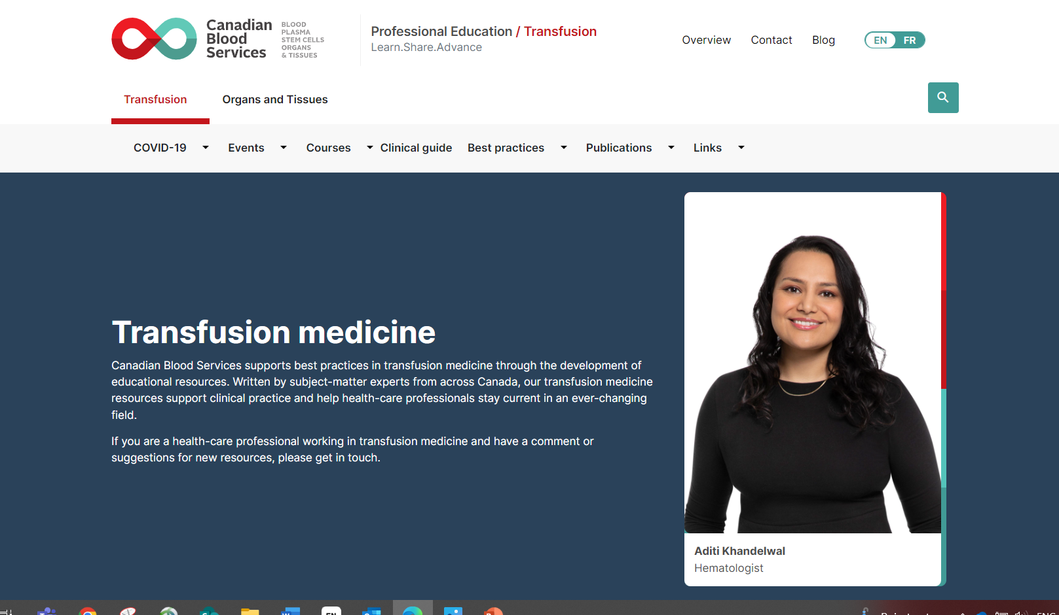
Additional resources
This document may be found on: Canadian Blood Services’ professional education website, profedu.ca​
Information is current to January 12, 2023. Always refer to the Product Monograph for up-to-date information. Our product portfolio (octapharma.ca)​
Notes:
Read slide

Slide 35
Resources
Octapharma Canada website (https://octapharma.ca)
Octaplasma product monograph
(https://octapharma.ca/en/therapies/product-overview)
FAQ: Solvent detergent (S/D) treated plasma (Octaplasma) (under publications on profedu.ca)
Including additional resources:
Octaplasma: Clinical overview slide deck – short version (also available as narrated video)
Octaplasma: Information for laboratory technologists slide deck (also available as narrated video)
Octaplasma (S/D plasma): One-page clinical summary
This document may be found on: Canadian Blood Services’ professional education website, profedu.ca​
Information is current to January 12, 2023. Always refer to the Product Monograph for up-to-date information. Our product portfolio (octapharma.ca)​
Notes:
This slide is for your reference and lists many excellent resources that are available.
Octapharma has prepared many educational resources that are available on their website. As well, the product monograph should always be consulted.
At Canadian Blood Services, there are various educational resources about S/D plasma and many other topics on the Professional Education website.

Slide 36

Contact
Please contact Octapharma with any questions about Octaplasma.
Please contact your local Hospital Liaison Specialist with any questions about Canadian Blood Services and plasma.
This document may be found on: Canadian Blood Services’ professional education website, profedu.ca​
Information is current to January 12, 2023. Always refer to the Product Monograph for up-to-date information. Our product portfolio (octapharma.ca)​
Notes:
Please contact Octapharma with any questions about Octaplasma.
Please contact your local Hospital Liaison Specialist with any questions about Canadian Blood Services and plasma

Slide 37
References
Saadah NH et al. Transition from fresh frozen plasma to solvent/detergent plasma in the Netherlands: comparing clinical use and transfusion reaction risks. Haematologica 105:1158-65 (2020).
Liumbruno GM and Franchini M. Solvent/detergent plasma: pharmaceutical characteristics and clinical experience. J Thromb Thrombolysis 39:118-28 (2015).
McGonigle AM et al. Solvent detergent treated pooled plasma and reduction of allergic transfusion reactions.Transfusion;60:54-61 (2020).
Klanderman RB et al. Reported transfusion-related acute lung injury associated with solvent/detergent plasma - A case series. Transfusion; 62: 594-99 (2022).
Sachs UJ et al. White blood cell-reactive antibodies are undetectable in solvent/detergent plasma. Transfusion; 45:1628-1631 (2005).
Verghese L. et al. Management of patients with factor XI deficiency—10 year case series and review of literature. Eur. J. Obstet. Gynecol. Reprod. Bio. 215, 85-92 (2017).
Scully M et al. Thrombotic thrombocytopenic purpura and pregnancy: presentation, management, and subsequent pregnancy outcomes. Blood. 124:211-9 (2014).
Camazine MN et al. Outcomes related to the use of frozen plasma or pooled solvent/detergent-treated plasma in critically ill children. Pediatr Criti Care Med. 18, e215-e223 (2017).
Spinella PC et al. Solvent/detergent-treated plasma in the management of pediatric patients who require replacement of multiple coagulation factors: an open-label, multicenter, post-marketing study. Front Pediatr. 8:572 (2020).
Kalsi A. et al. Comparison of the coagulation effect achieved by OctaplasLG versus fresh frozen plasma in pediatric cardiac surgical patients. Clin Appl Thromb Hemost. 24:1327-32 (2018).
Josephson CD et al. Safety and tolerability of solvent/detergent-treated plasma for pediatric patients requiring therapeutic plasma exchange: An open-label, multicenter, postmarketing study. Transfusion 62:396-405 (2022).
Chekrizova V and Murphy WG. Solvent-detergent plasma: use in neonatal patients, in adult and paediatric patients with liver disease and in obstetric and gynaecological emergencies. Transfus Med; 16:85-91 (2006).
This document may be found on: Canadian Blood Services’ professional education website, profedu.ca​
Information is current to January 12, 2023. Always refer to the Product Monograph for up-to-date information. Our product portfolio (octapharma.ca)​

