Slide 1
Pathogen-reduced platelets: clinical highlights
October 2022
Source: Canadian Blood Services’ professional education website, profedu.ca

Slide 2
Acronyms
Acronym | Name
PPPT | Pooled platelet psoralen-treated
APPT | Apheresis platelet psoralen-treated
PIT | Pathogen inactivation technology
PRT | Pathogen reduction technology
PAS | Platelet additive solution PAS-E is the formulation of PAS used at Canadian Blood Services
Source: Canadian Blood Services’ professional education website, profedu.ca
Notes:
PPPT and APPT are types of pathogen-reduced platelets
PIT and PRT are interchangeable terms

Slide 3



Pathogen inactivation technology
PIT reduces the risk of transfusion-transmitted pathogen infections and provides an additional layer of safety against:
      Viruses (enveloped and non-enveloped)
      Bacteria (gram-positive, gram-negative, spirochete)
      Protozoa parasites
      White blood cells (leukocytes), which can no longer replicate and produce cytokines, rendering irradiation unnecessary
Source: Canadian Blood Services’ professional education website, profedu.ca
Notes:
Bacterial contamination remains a risk following blood transfusion, particularly with platelet components as they are stored at room temperature. Pathogen inactivation technology reduces the risk of transfusion-transmitted pathogen infections and provides an additional layer of safety against: (read out the slide).

Slide 4
Terminology
At Canadian Blood Services, Cerus’ INTERCEPT pathogen inactivation technology (PIT) will be used to manufacture pathogen-reduced platelet components.
Pathogen-reduced platelets are also known as:
INTERCEPT platelets
Pathogen reduction technology (PRT) platelets
Psoralen-treated platelets
Other terms:
Pooled platelets psoralen-treated (PPPT)
Apheresis platelets psoralen-treated (APPT)
Source: Canadian Blood Services’ professional education website, profedu.ca
Notes:
(Read slide)
Other terms of relevance include pooled platelets psoralen-treated (PPPT) and apheresis platelets psoralen-treated (APPT), which refer to specific types of pathogen-reduced platelets.

Slide 5
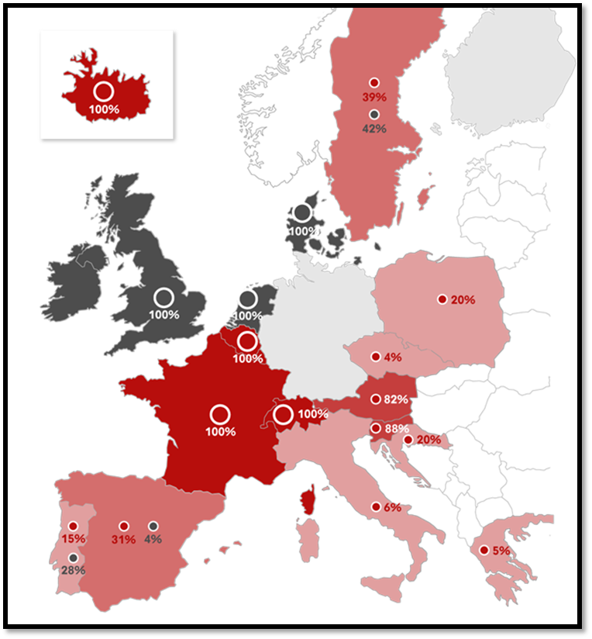
Safety
Amotosalen safety profile
Toxicity extensively studied
Minimal residual amotosalen
In vitro, animal model, and European hemovigilance data suggests safe
About INTERCEPT (provided by Cerus):
Commercialized for nearly 20 years
Adopted for the treatment of >50% of platelets produced in 10 Countries‡
Approx. 8.5 million INTERCEPT treated doses globally (plasma and platelets)*
Pathogen inactivated platelet concentrates
Platelet concentrates screened for bacteria
Platelet concentrates with neither bacterial screening nor pathogen inactivation
Source: Cerus 2018 data on file
‡Countries where INTERCEPT is standard of care, treating >50% of platelets
*Dose treated estimates for platelet and plasma based on the number of kits sold to date
Notes:
The toxicity of psoralen-based treatments has been extensively studied in in vitro, in animal studies, and in clinical trials. The residual amotosalen amount after platelet preparation is minimal and falls well below toxic thresholds. It is important to highlight that while pathogen reduced platelets are new to Canada, they have been routinely used in Europe since the mid-2000s. INTERCEPT has been commercialized for nearly 20 years, with approximately 8.5 million intercept treated products administered globally. Large multinational hemovigilance databases have confirmed the excellent safety profile seen in the preclinical studies.

Slide 6
Platelet components
Existing components, in plasma
Untreated pooled platelet (Pooled platelets LR CPD)
Untreated apheresis platelet (Apheresis platelet)
New platelet components, in platelet additive solution (PAS-E)
Pooled platelet psoralen-treated (PPPT)
Apheresis platelet psoralen-treated (APPT)*
Untreated apheresis platelet, in PAS-E*
*APPT and untreated apheresis platelets in PAS-E require Health Canada approval and are not currently available in Canada.
Source: Canadian Blood Services’ professional education website, profedu.ca
Notes:
Currently, two untreated or non-pathogen reduced platelet products are manufactured by Canadian Blood Services – untreated pooled platelets in plasma and untreated apheresis platelets in plasma. In December 2021, Health Canada approved the use of Cerus’ INTERCEPT Pathogen Inactivation Technology for manufacturing pooled platelets psoralen-treated (PPPT) at Canadian Blood Services. PPPT was introduced by Canadian Blood Services at select hospitals in January 2022, and production will roll out across production centers in 2023.
Canadian blood services will also be submitting to Health Canada applications for the manufacturing of 2 new platelet products - apheresis platelet psoralen treated (APPT) and untreated apheresis platelet in PAS-E. Implementation is pending Health Canada approval and these products are not currently available in Canada.
For details on component characteristics, please see the component focused slide deck and video available, circular of information, as well as the professional education chapter on pathogen reduced platelets.

Slide 7
What is platelet additive solution (PAS)
PAS was developed to partially replace plasma in platelet components
Results in additional dilution of plasma proteins, cytokines, iso-agglutinins (anti-A, anti-B, anti-A/B), and other bio-active molecules
Helps reduce the incidence of allergic reactions and febrile non-hemolytic transfusion reactions^{1,2}
No differences in hemostasis and transfusion intervals³
Source: Canadian Blood Services’ professional education website, profedu.ca
Notes:
PAS is a crystalloid nutrient media designed to replace a portion of plasma within platelet units. Because it dilutes plasma proteins, cytokines, iso-agglutinins, and other bioactive molecules in the component - PAS stored platelets have a reduced risk of allergic and febrile non-hemolytic transfusion reactions and reduces antibodies like anti-A and anti-B in the component. There are no differences reported in hemostasis and transfusion intervals in clinical studies.

Slide 8
Clinical indications
Pathogen-reduced platelets have the same indications as untreated platelets with the following additional considerations:
Irradiation not required/indicated
CMV negative
Source: Canadian Blood Services’ professional education website, profedu.ca
Notes:
(Read slide)

Slide 9
Contraindications
Pathogen-reduced platelets have the same contraindications as untreated platelets with the following additions:
Contraindicated for patients with a history of hypersensitivity reaction to amotosalen or other psoralens
Contraindicated for neonatal patients treated with phototherapy devices that emit a peak energy wavelength less than 425 nm, OR have a lower bound of the emission bandwidth <375 nm, due to the potential for erythema resulting from interaction between ultraviolet light and amotosalen
Source: Canadian Blood Services’ professional education website, profedu.ca
Notes:
(Read slide)
It should be noted that phototherapy with blue-green light, which is in the safe wavelength range, is the current standard of care for treatment neonatal hyperbilirubinemia in Canada. For patients with these contraindications, Canadian Blood Services will continue to offer non pathogen reduced platelets as needed.

Slide 10
Benefits of pathogen-reduced platelets
Reduces bacterial contamination risk and risks of other transfusion-transmitted infections^{4,5}
  complements donor selection criteria and pre-transfusion pathogen testing performed for all donations
No need for routine BACT bacterial screening before release into inventory
White blood cell inactivation – irradiation is NOT required
  Contributes toward reducing the risk of TA-GVHD*
  Simpler ordering process and inventory management
Considered CMV negative
*Ta-GvHD: Transfusion-associated graft versus host disease
Source: Canadian Blood Services’ professional education website, profedu.ca
Notes:
Pathogen reduced platelets are associated with multiple benefits.
Pathogen reduced platelets significantly reduces the risk of bacterial contamination,and complements donor selection criteria and pre-transfusion pathogen testing performed for all donations. As PIT eliminates the need for platelets to undergo bacterial testing, pathogen reduced platelets are released approximately 24 hours before untreated platelets. Since amotosalen nonspecifically intercalates in the DNA and RNA of organisms and viruses, PIT provides an additional layer of safety for platelet components against known and unknown pathogens. PIT complements the donor selection criteria and pre-transfusion pathogen testing performed for all donations.
Because pathogen inactivation inhibits white cell replication and cytokine production, irradiation to prevent transfusion-associated graft versus host disease are no longer needed. This simplifies the ordering process and inventory management for hospitals. Similarly, the need for cytomegalovirus (CMV)-negative blood components, already limited, is removed because pathogen inactivated platelets are considered CMV-negative.

Slide 11
Benefits of pathogen-reduced platelets
Safety endpoints from clinical trials and published hemovigilance data shows favorable adverse reaction and safety profile^{4,6}
Fewer allergic and febrile non-hemolytic transfusion reactions^{7,8}
Signals of safety (compared to untreated platelets) – Cochrane review, 2017⁶:
  No change in thromboembolism, anaphylaxis, acute transfusion reactions
  No increase in adverse events in clinical trials
Short-term safety and efficacy have been demonstrated in pediatric patients and in neonates^{9,10}
Source: Canadian Blood Services’ professional education website, profedu.ca
Notes:
(Read slide)

Slide 12
Clinical outcomes and drawbacks
Pathogen-reduced vs untreated platelets
No differences in mortality, any bleeding event (WHO Grade 1-4), clinically significant bleeding (Grade 2/more) or severe bleeding (Grade 3/4)⁶
Platelet count increments and transfusion requirements
Lower correct count increment (CCI) at 1 and 24 hours
7% more platelet transfusions (published ranges from 0-30%)
Shorter transfusion interval between platelets (avg. 0.5 days less between transfusion)
Platelet refractoriness was observed more often (not HLA Ab-mediated)
Source: Canadian Blood Services’ professional education website, profedu.ca
Notes:
With regards to clinical outcomes, there have been no differences reported in mortality, any bleeding event, clinically significant bleeding or severe bleeding when pathogen reduced platelets are compared to untreated platelets.
Studies have shown that pathogen reduced platelets lead to lower corrected count increments, increase in the number of platelet transfusions, and a shorter time interval between transfusions compared those who received untreated platelets . These differences, however, are small as outlined on the slide. Non-immune platelet refractoriness is also more frequently observed.
.

Slide 13
A note about clinical efficacy - PLADO trial¹¹
Method
  Prophylactic platelet transfusion to hematologic cancer and solid tumor patients
  Received low (1.1x10¹¹), medium (2.2x10¹¹), or high (4.4x10¹¹) dose when platelet count was less than 10,000/L
  Primary endpoint: Grade 2 or higher bleeding defined by WHO
Result
  Significant bleeding did not differ between groups
  Trials with pathogen-reduced platelets also did not observe an increased bleeding risk due to fewer platelets in a platelet dose.⁸
Source: Canadian Blood Services’ professional education website, profedu.ca
Notes:
While the count increments may be lower following transfusion with pathogen-reduced platelets, it is important to remember – as shown by the landmark PLADO trial of variable platelet doses – that while more platelet doses may be required, clinical bleeding is NOT increased. Again, trials with pathogen reduced platelets also did not observe an increased bleeding risk.

Slide 14
Neonatal and intrauterine transfusions
Several studies have described pathogen reduced platelet use in pediatrics and neonatal populations
No indications of harm
  Largest study Delaney et al. > 3800 pediatric patients across 4 centres, 2013-2019 (1,188 patients under 4 months)¹²
No long-term studies
No published studies in intrauterine transfusions
Benefit and risks should be assessed and balanced before using pathogen-reduced platelets in these settings
Source: Canadian Blood Services’ professional education website, profedu.ca
Notes:
Since the approval of INTERCEPT treated platelets internationally, several studies have described the safety of these components in pediatric and neonatal patient populations. There is no indications of harm in published studies. The largest of these is published by Delaney and colleagues, who reported on 1,188 patients under 4 months who received pathogen reduced platelets without issue. Short-term safety data have demonstrated safety, but long-term data are currently limited. There is no published evidence for the use of INTERCEPT platelets for intrauterine platelet transfusions – for which non pathogen reduced components will remain available. Benefit and risks should be assessed and balanced before using pathogen reduced platelet in these settings

Slide 15
Resources
Canadian Blood Services professional education website (profedu.ca)
  Clinical Guide to Transfusion, Chapter 19, Pathogen-reduced platelets
  Clinical slide deck (also available as narrated video)
  Component slide deck (also available as narrated video)
  Clinical highlights slide deck (also available as narrated video)
  FAQ: Information for health professionals on pathogen-reduced platelets
Canadian Blood Services website (blood.ca)
  Circular of Information
INTERCEPT package insert: intercept-canada.com
Ontario Regional Blood Coordinating Network (ORBCoN) information on pathogen-reduced pooled platelets: Information on Pathogen Reduced Pooled Platelets – Transfusion Ontario
Source: Canadian Blood Services’ professional education website, profedu.ca
Notes:
To point out:
If surfing on Web, beware of different regulatory requirements applicable depending on jurisdictions.

Slide 16
References
1. Mertes PM et al. Hypersensitivity Transfusion Reactions to Platelet Concentrate: A Retrospective Analysis of the French Hemovigilance Network. Transfusion 2020;60:507-12.
2. Mowla SJ et al. A Comparison of Transfusion-Related Adverse Reactions among Apheresis Platelets, Whole Blood-Derived Platelets, and Platelets Subjected to Pathogen Reduction Technology as Reported to the National Healthcare Safety Network Hemovigilance Module. Transfus Med Rev 2021;35: 78-84.
3. Kerkhoffs J-LH et al. A Multicenter Randomized Study of the Efficacy of Transfusions with Platelets Stored in Platelet Additive Solution Versus Plasma. Blood 2006;108:3210-5.
4. Knutson F et al. A Prospective, Active Haemovigilance Study with Combined Cohort Analysis of 19,175 Transfusions of Platelet Components Prepared with Amotosalen-UVA Photochemical Treatment. Vox Sang 2015;109:343-52.
5. Benjamin RJ et al. Hemovigilance Monitoring of Platelet Septic Reactions with Effective Bacterial Protection Systems. Transfusion 2017;57:2946-57.
6. Estcourt LJ et al. Pathogen‐Reduced Platelets for the Prevention of Bleeding. Cochrane Database of Systematic Reviews 2017.
7. Garban F et al. Comparison of the Hemostatic Efficacy of Pathogen-Reduced Platelets Vs Untreated Platelets in Patients with Thrombocytopenia and Malignant Hematologic Diseases: A Randomized Clinical Trial. JAMA Oncology 2018;4:468-75.
8. Jutzi M, Mansouri Taleghani B, Rueesch M, Amsler L, Buser A. Nationwide Implementation of Pathogen Inactivation for All Platelet Concentrates in Switzerland. Transfus Med Hemother 2018;45:151-6.
9. Schulz WL et al. Blood Utilization and Transfusion Reactions in Pediatric Patients Transfused with Conventional or Pathogen Reduced Platelets. J Pediatr 2019;209:220-5.
10. Jimenez-Marco T et al. Use and Safety of Riboflavin and Uv Light-Treated Platelet Transfusions in Children over a Five-Year Period: Focusing on Neonates. Transfusion 2019;59:3580-8.
11. Slichter SJ, et al. Dose of prophylactic platelet transfusions and prevention of hemorrhage. N Engl J Med 2010;362(7):600-13
12. Delaney M et al,. Multinational Analysis of Transfusion Reactions in Children Transfused with Pathogen Inactivated Platelets. 2021 AABB Annual Meeting, Virtual, Transfusion 2021
Source: Canadian Blood Services’ professional education website, profedu.ca

Slide 17
Together, we are Canada’s Lifeline

